Slide 1
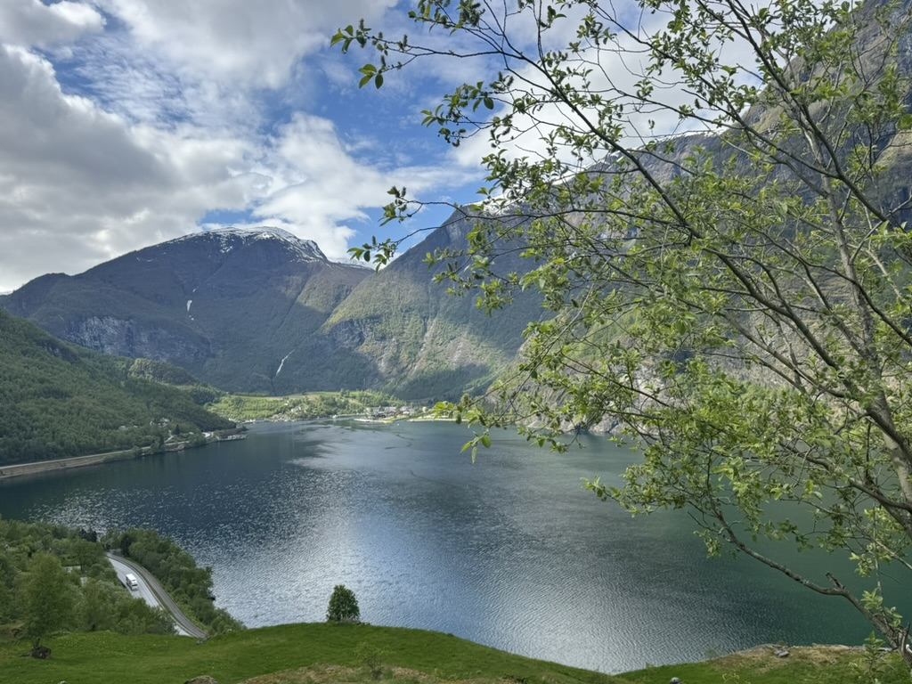
Leading Change- in a changing world
Daniel Hyman, MD, MMM
Adjunct Professor, Pediatrics,
Perelman School of Medicine
University of Pennsylvania
May 2026
Aurlandsfjord, Norway

Slide 2
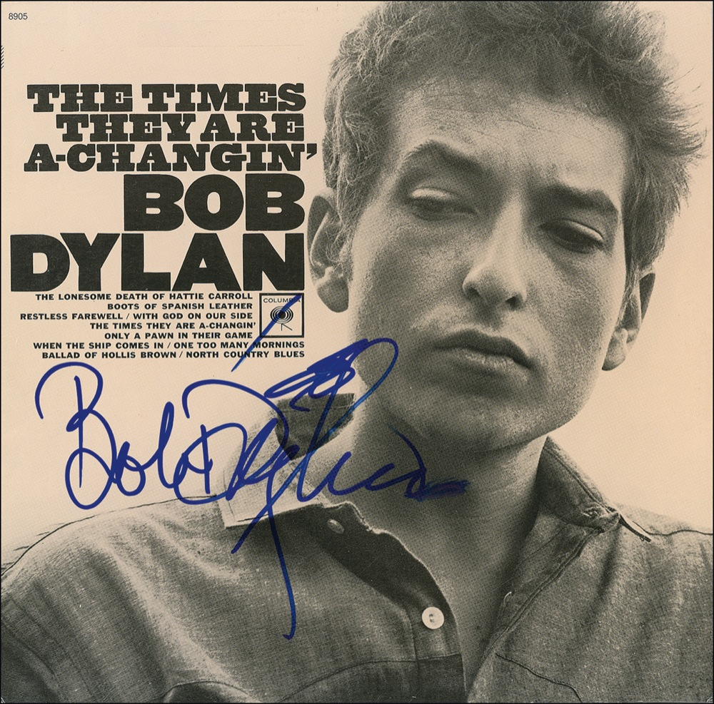
Come gather 'round people Wherever you roam And admit that the waters Around you have grown And accept it that soon You'll be drenched to the bone If your time to you is worth savin' And you better start swimmin' Or you'll sink like a stone For the times they are a-changin'

Slide 3
Session Objectives
Review 3 principles/theories of effective change management
Diffusion of Innovation
Kotter, Leading Change; “Why Change Efforts Fail” (HBR)
Institute for Healthcare Improvement, Change Management Model
What is different about leading change today?
From theory to practice- what does this mean for you?
Robust, open dialog!

Slide 4
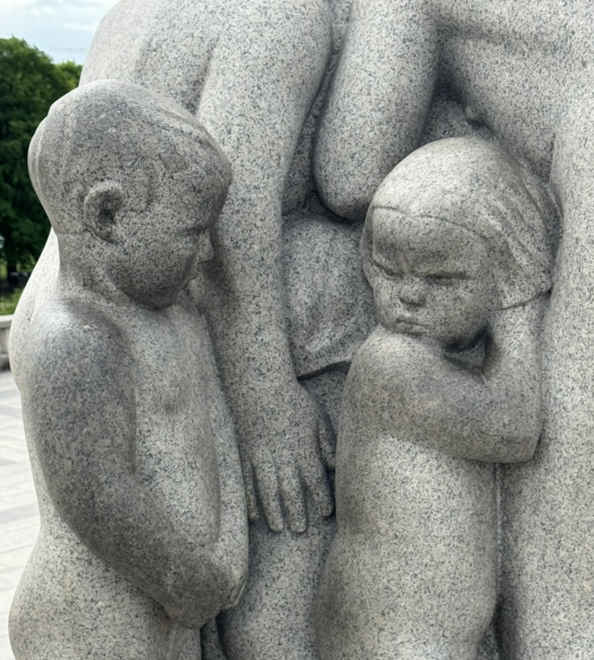
Conflict of Interest
The speaker has reported the following conflicts of interest with ineligible companies.
-ownership share in a biomedical device company
(will not be discussed)
Vigeland Sculpture Garden,
Oslo, Norway

Slide 5
3 Framing Hypotheses
The principles and theories of leading change espoused by Kotter (1995), the IHI (2018) (and others) remain relevant and useful
All change must be planned and executed with a solid understanding of the situation and context
“No strategic plan survives its execution”
Leaders engaged in change efforts today must consider and account for the rapidly changing care environment/context in which we are working- “the systems”
We should add a “new box” to our Key Driver Diagram templates

Slide 6
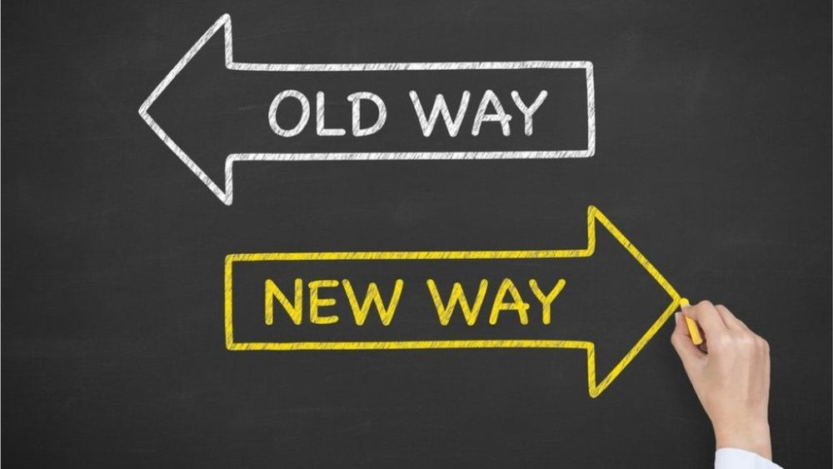
Let’s try something…
“Progress is impossible without change”
-George Bernard Shaw

Slide 7
Turn and Talk!- 1 minute
We asked you to do something that involved a change.
What made it uncomfortable?

Slide 8
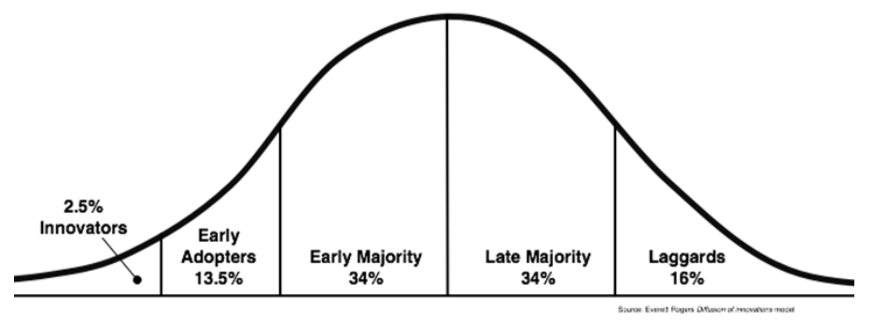
Diffusion of innovation- Theoretical frame

Slide 9
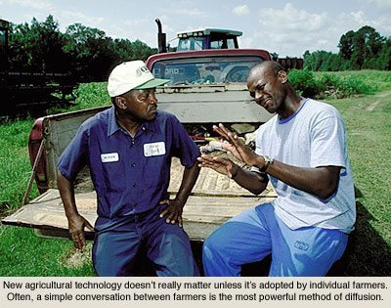
Diffusion of innovation

Slide 10
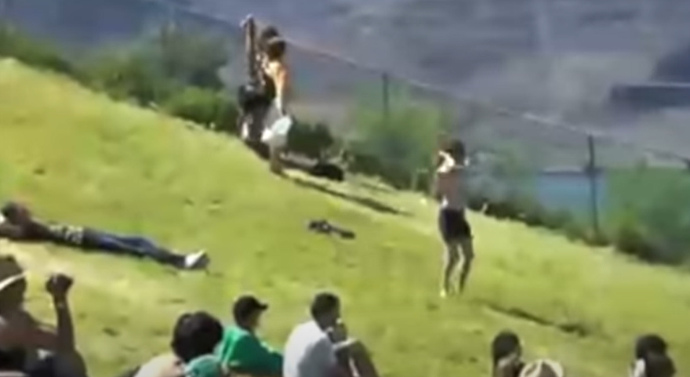
Diffusion of innovation
First Follower: Leadership Lessons from Dancing Guy - https://www.youtube.com/watch?v=fW8amMCVAJQ
Notes:
Could also have shown the end of dead poets society

Slide 11
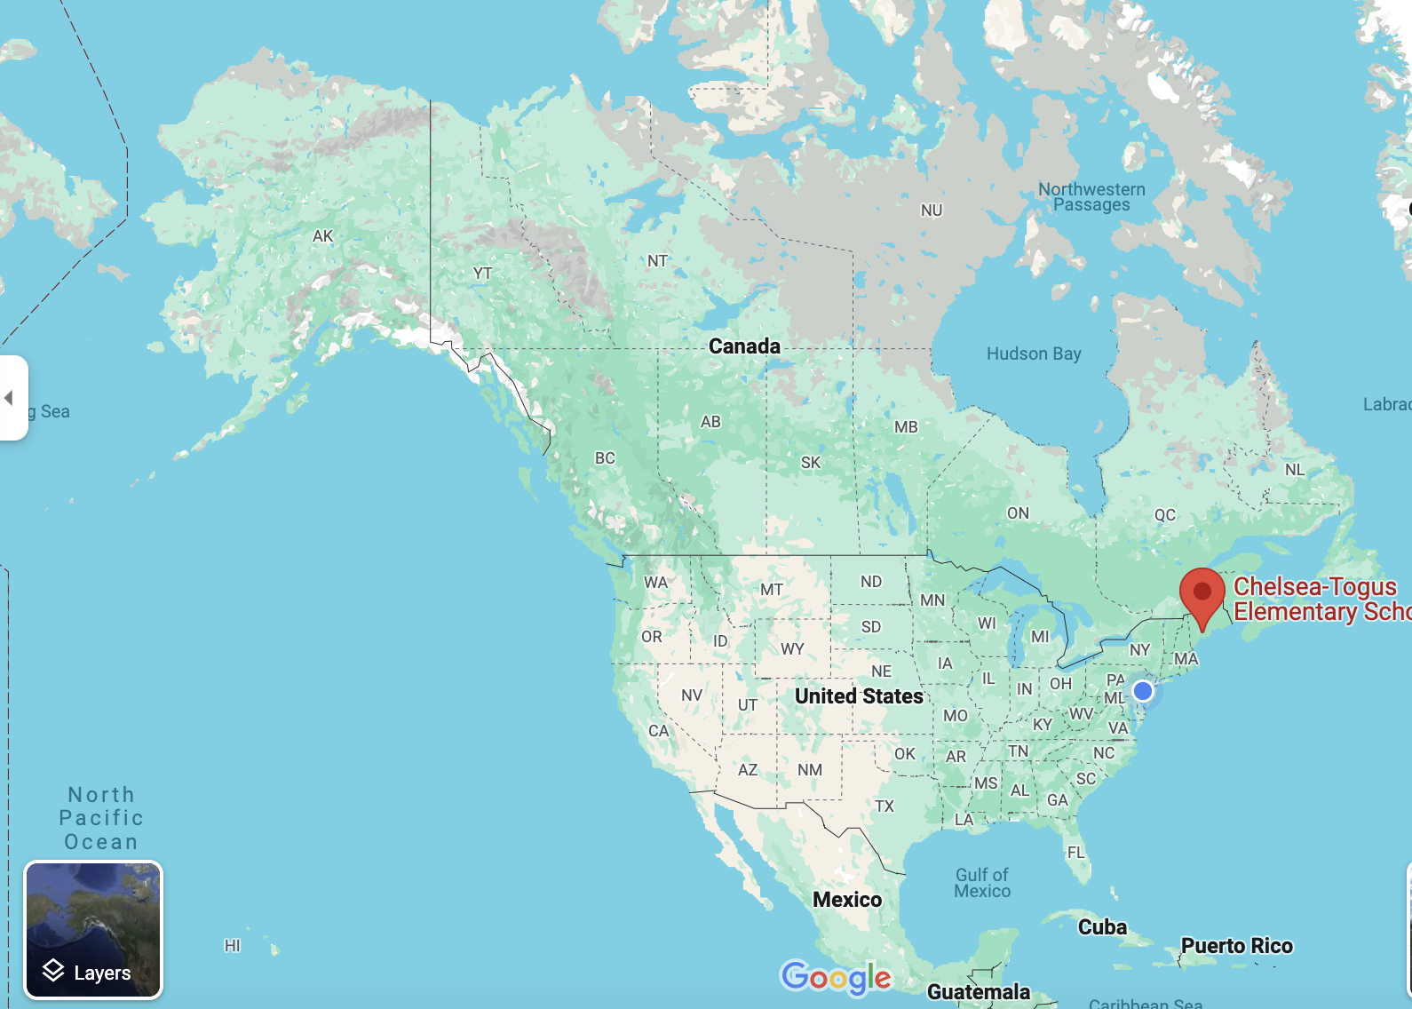
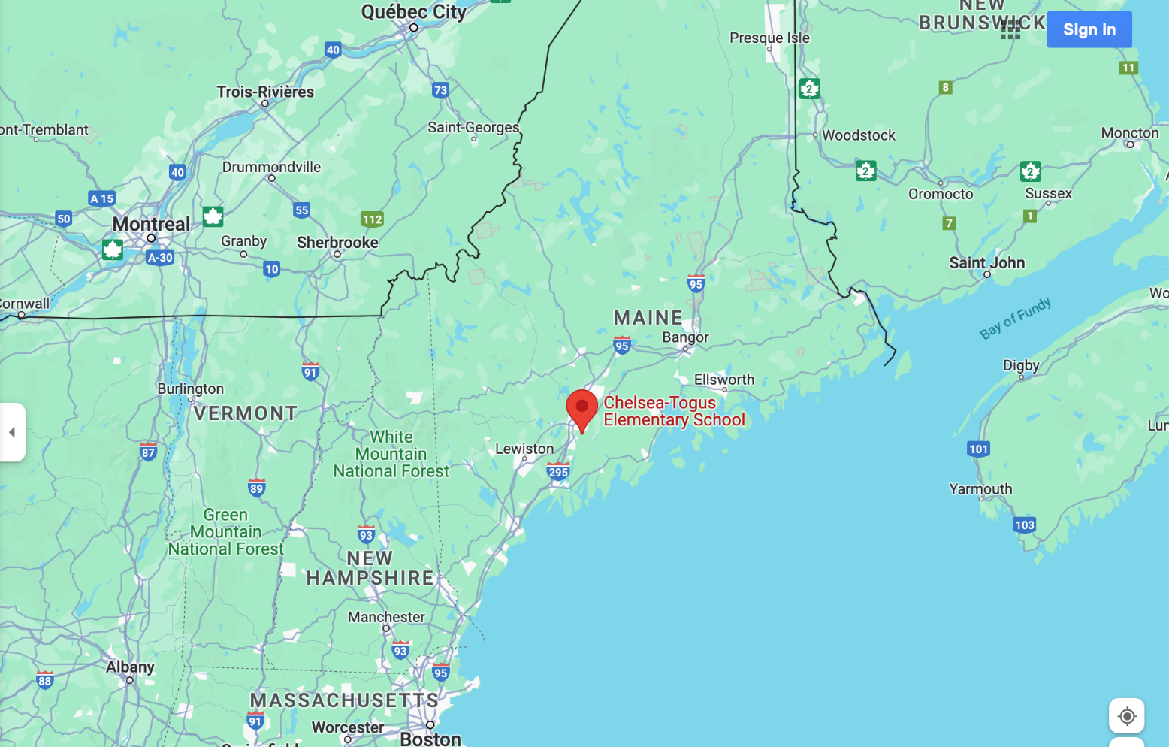

Dapper Wednesdays in Maine!
Notes:
James Ramage, left, Dean Paquette and Lincoln Bolitho

Slide 12


https://www.youtube.com/watch?v=904sBohiYr4

Slide 13
Diffusion of innovation- Theoretical frame
What about the innovations that get to early adopters but then fizzle out? What can we learn from them?

Slide 14
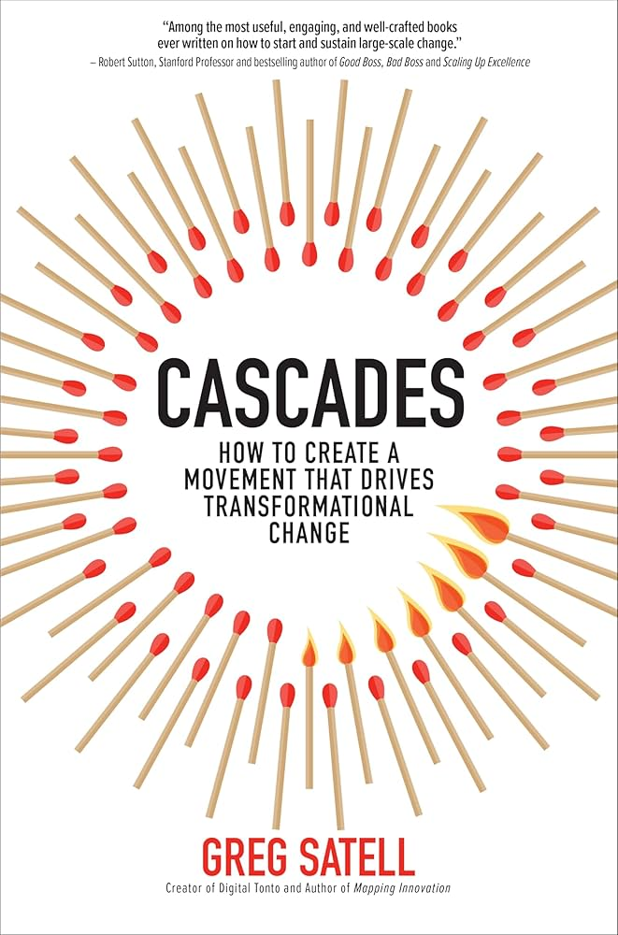
Two aspects of successful movements:
“Small groups, loosely connected, united by a common purpose”
“Planning, Organization and Discipline”

Slide 15
Diffusion of innovation
Key Takeaways
Leaders must nurture the relationship with their first follower(s)
Leaders should make their change public and easy to follow… It is the cascading that leads to sustainability
The first follower(s) transforms the person alone into a leader (it takes guts to be a first follower)
Leaders should make everything about the change (Not themselves.. Think Cascade!)

Slide 16

No model is perfect…. But some are more useful than others
Mt. Bierstadt, 14,065 feet

Slide 17
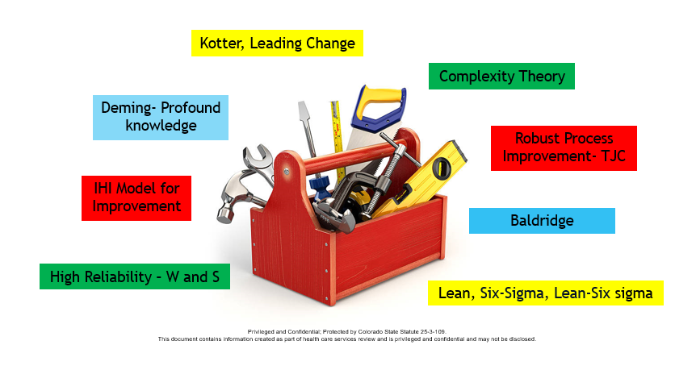
What's in your change toolbox?

Slide 18
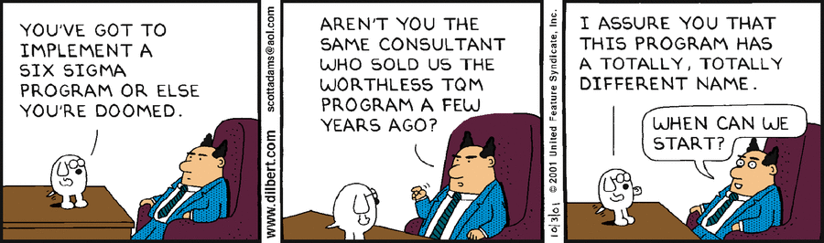

Slide 19
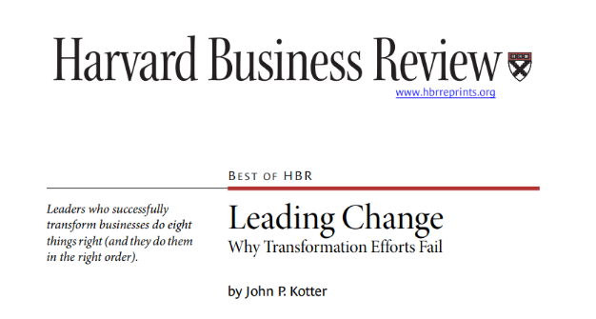
Kotter’s 8-Step Change Management Model

Slide 20
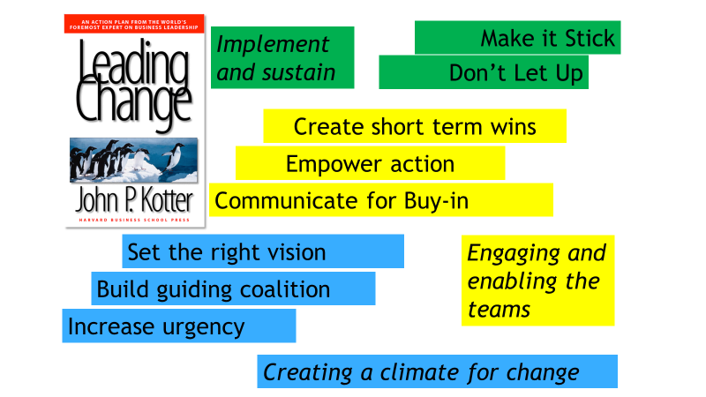

Slide 21

How does one create
a sense of urgency?
Mt. Bierstadt, 14,065 feet

Slide 22




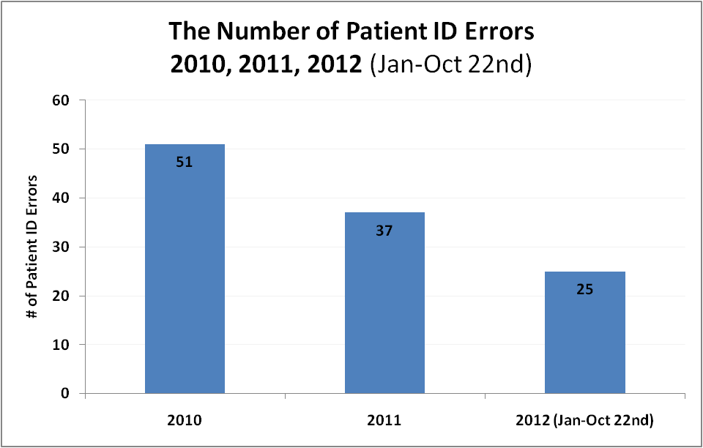

The usual story- we are great, we are growing, and we are improving

Slide 23

There is a darker side to the story…..
Chateau de Chillon, Switzerland

Slide 24

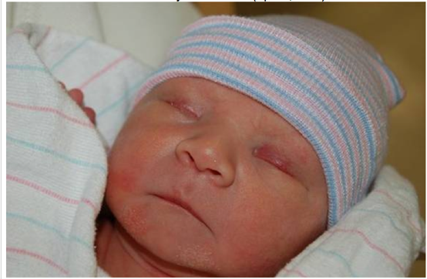
In our hospital …
Alyssa
Grant

Slide 25
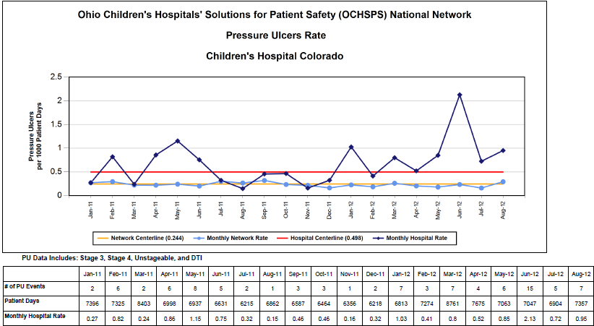
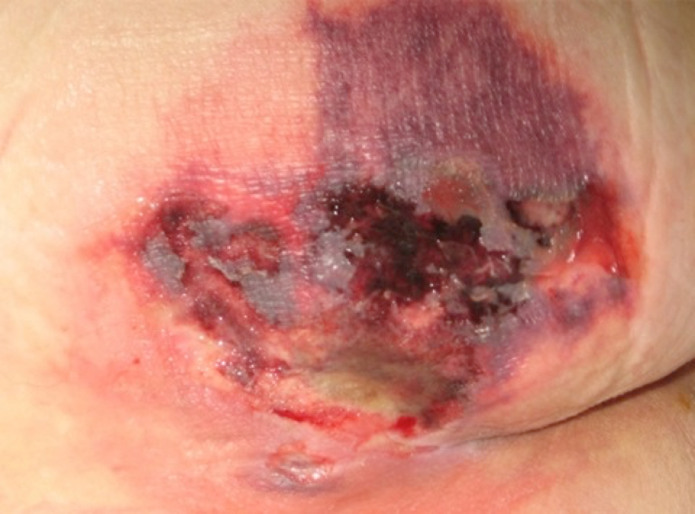

Slide 26



Slide 27
Turn and Talk! -2 minutes
(New grantees) What is a way you might “create urgency” for your project?
(Others)- how have you successfully created urgency for your project? (or seen others do so)

Slide 28
Creating Urgency
Pictures and Stories
Make it personal
Aim for the heart
Make the status quo uncomfortable- describe a better, more aspirational vision

Slide 29

Build a guiding coalition
Dillon Reservoir, Swan Mountain Road, Keystone, CO

Slide 30
Authority/Power/Influence
Subject Matter Expertise and Credibility
Advocates and “Soft skeptics”
Multidisciplinary- consider patients/families
Form a powerful guiding coalition
Executive Sponsorship impact can not be overestimated!

Slide 31
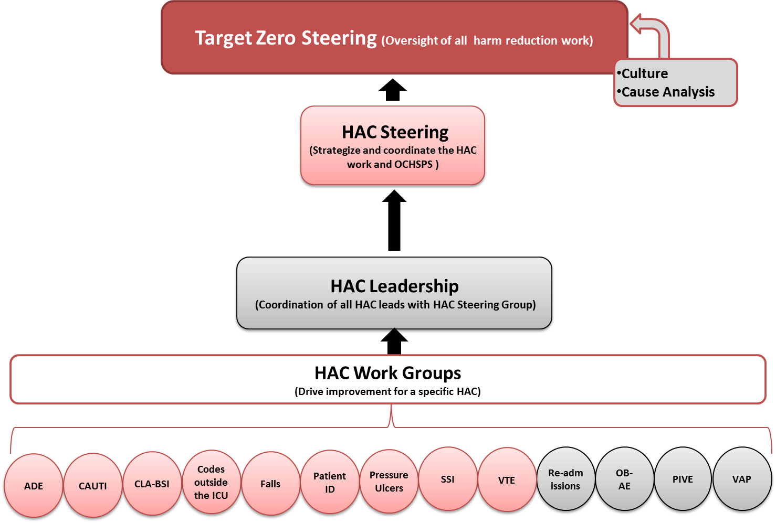
Who might you ask to be on your guiding coalition?
Target Zero Governance
Children's Colorado
@CHOP:
Breakthrough to Zero
Exec Safety Steering
Patient Safety Committee
Breakthrough to Zero Steering
Harm indicator and culture teams

Slide 32

Get the right vision
Steamboat Springs, CO

Slide 33

Create a Vision […and your Aim(s)]
What is our overarching, motivating goal?
Can we easily communicate our plan to achieve our goal?
Now we can get specific as to our aim(s)

Slide 34
CHCO/SPS Vision- “Progressive Elimination of Preventable Harm”
Safety Behaviors for Error Prevention
Leadership Methods
Patient Family Engagement
High Reliability Organization, Safety 1 --- > 2
Cause Analysis
Harm Indicator Prevention Bundles
Safety Governance
Culture of
Safety

Slide 35
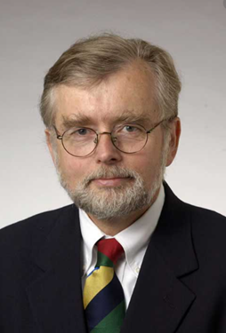
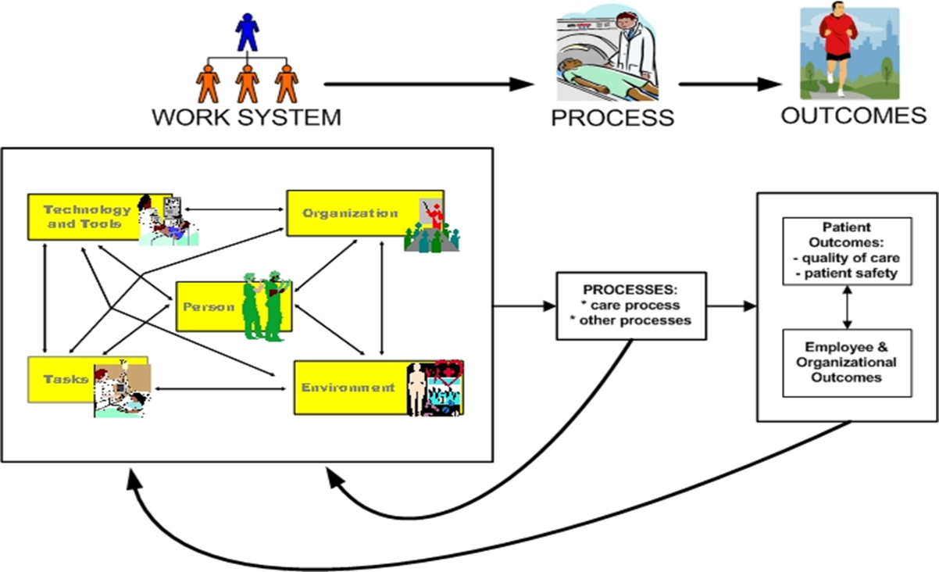
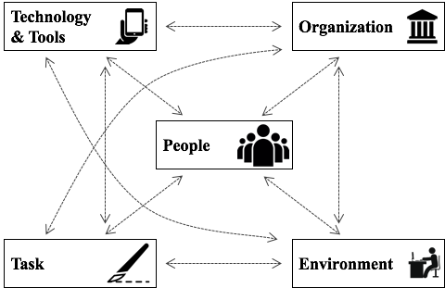
The First Rule of Quality Improvement
“Every system is perfectly designed…. to get the results it gets”
Dr. Paul Batalden
Dartmouth University Institute for Health Policy/School of Medicine
Notes:
I will have included this in m1 but will reinforce it here- that if we are trying to change anything, the result we have and the one we will get are functions of the system in which we are working, and so we need to incorporate our change management principles so as to impact the system of care we are leading.
Both batalden quotes on the slide can be reinforced.

Slide 36
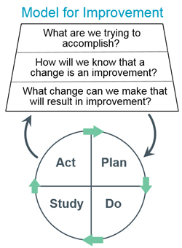
Create a vision
And then….. Employ robust quality improvement methods to reach your aim(s)!

Slide 37
Primary Drivers
Secondary Drivers
Potential Action Items
Key Driver Diagram
Global Aim/Vision:
SMART Aim:

Slide 38
GRANTEES | VISION
Greater Regional, Creston IA | Reduced fragmentation post acute care…”improve safety/outcomes”
North Dakota State College of Science- Whapeton, ND | Community Health Care Worker Program- “improve rural/tribal outcomes”
City Care, Oklahoma, OK | Recuperative and support care for people experiencing homelessness- “safe transition”
MedStar Health Research Institute, Columbia, MD | AI enabled improvement in follow-up of incidental imaging findings- “reduce missed diagnoses of cancer”
Promise Healthcare, Champaign, IL | Reduce perinatal care fragmentation for low-income/uninsured- “improve outcomes/reduce maternal morbidity/mortality
Northwest Center, SeaTac, WA | Reduce care fragmentation, NICU to home- “Strengthen continuity of care”
Notes:
Use some sharpening examples for vision- - we will not see infants failing to thrive or needing readmission, mothers struggling because of breakdowns in care coordination
Promise/ NW Center-
Med Star- we will leverage the power of AI to prevent patients from having poorer prognoses for cancer treatment due to missed test results leading to delayed diagnoses test results.
COPIC GRANTEES
Creston IA- Greater Regional medical Center- post-acute care safety program- expand clinical capacity, standardize in home risk assessment, improve communication and integration— to reduce “adverse fragmentation events”- improve safety and outcomes
Whapeton ND- ND State College of Science - community health worker certification program to reduce poor outcomes in rural and tribal communities- curriculum development, clinical site partnerships, outreach to partners, engage advisory board
Oklahoma City OK_ City Care- provide short term recuperative care for people experiencing homelessness;- daily wellness checks, access to recovery and support services, coordinated care medical and behavioral- transition to permanent housing
Columbia MD- MedStart health research- prevent missed CA after incidental imaging findings. AI enabled virtual pulmonary nodule clinic- strengthens followup reduces missed dx
Promise Healthcare
Champaign, IL
The Mothers Matter program will reduce healthcare fragmentation for low-income and uninsured Black and Hispanic perinatal women from pregnancy through 12 months postpartum. Promise Healthcare, an FQHC, will implement cross-sector perinatal care coordination, expand mental health supports, and deliver trauma-informed perinatal training in partnership with the local hospital and public health department. Support for this program will improve birth outcomes and reduce maternal mortality and morbidity by strengthening continuity of care across systems.
Northwest Center
SeaTac, WA
Funding will support two communities outside Washington State in reducing care fragmentation during the NICU-to-home transition. Grounded in the evidence-based Hospital-to-Home Care Model, this initiative provides a replicable framework that can be adapted and scaled to meet diverse community needs, addressing the persistent “service cliff” families face after NICU discharge and strengthening continuity of care for fragile infants and their caregivers.

Slide 39
Connecting vision to purpose
Focus on the human impact
Who are we serving?
Use ”So That….“ statements
External impacts/what the patient experiences
(Note: you do need to write a SMART Aim as well)
To… No child’s health outcome will be impacted by zip code
FROM…
Enhance Health Equity

Slide 40
To…No patient will be readmitted due to provider/team miscommunication
FROM…
Improve outcomes (or reduce fragmentation...)
To… No patient will experience delayed diagnosis because we didn’t follow up on significant results
FROM…
Reduce missed diagnoses of cancer

Slide 41

Communicate for Buy-in
Steamboat Springs, CO

Slide 42
Communicate the vision
Create Buy-in
Simple: No jargon.
Vivid: A verbal picture is worth a thousand words – use metaphor, analogy, and example.
Repeatable: Ideas should be able to be spread by anyone to anyone.
Invitational: Two-way communication is always more powerful than one-way communication
Notes:
Meetings “start with safety”
Proactive organizational communications - TAUT (timely, accurate, useful, targeted)
Daily organizational brief
Leader rounding informed by topical project communications
Landing page of intranet – “days since”, links to dashboards
Monthly Open Forum - MM&I/Conferences
Interactive games, prizes, swag
Great catch awards
Still could do a better job with learning from serious events
Data sharing everywhere
Interactive games, prizes, swag

Slide 43

Empower Action
Vail (?), CO

Slide 44
Empower others to act on that vision
Remove obstacles
Put in place a structure for change

Slide 45

Create short term wins
Columbine, My favorite wildflower

Slide 46
Plan for and create short term wins
Nothing motivates more than success
Focus on results that staff can see
Celebrate and recognize successes
Notes:
Successes can be outcome, process, balance or just really good work in support of project
Make it visible- pictures cake etc.

Slide 47

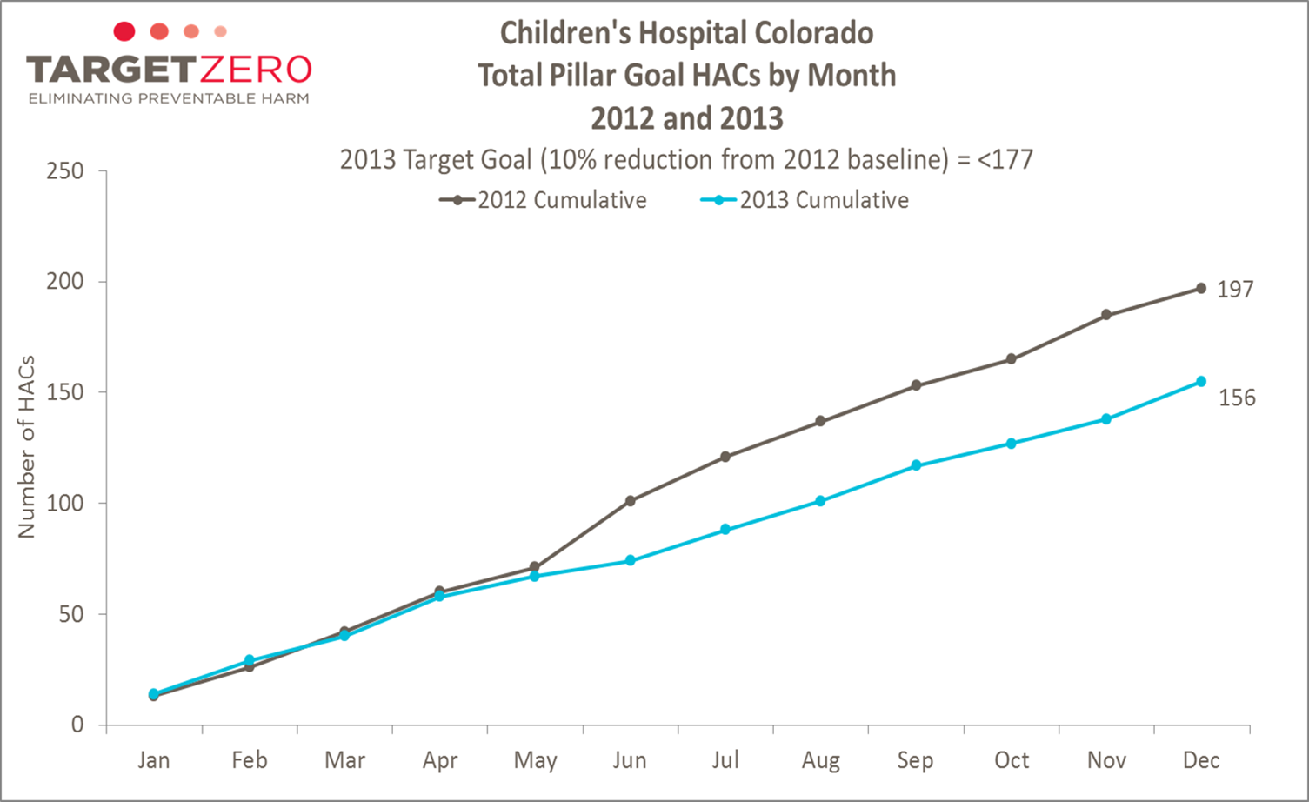

Slide 48
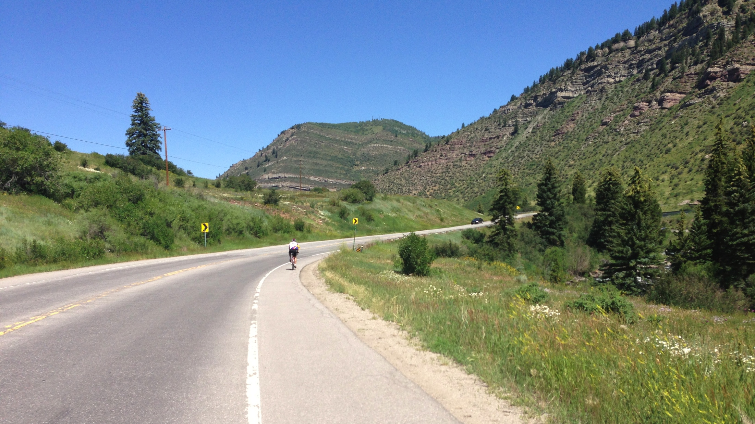
Don’t Let Up
Battle Mountain, outside Minturn, CO

Slide 49
Each success provides an opportunity to build on what went right
Empower employees at all levels to lead projects
Constant effort to keep urgency high
Consistent show of proof that the new way is working
Consolidate improvements and create more change

Slide 50
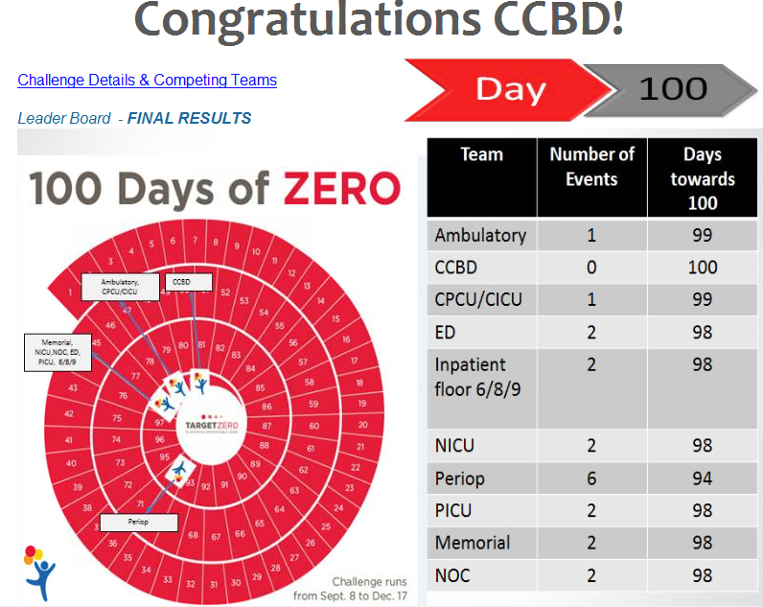
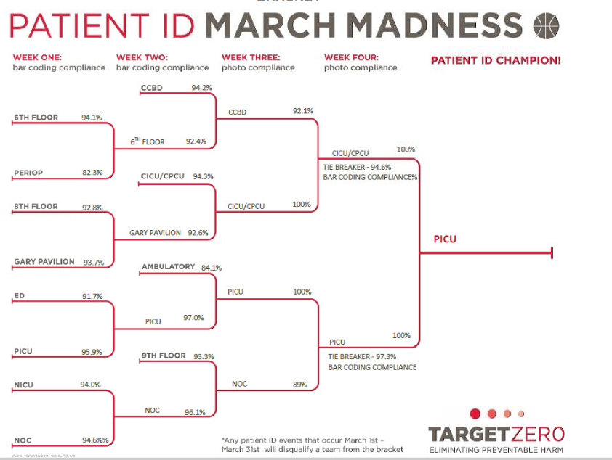
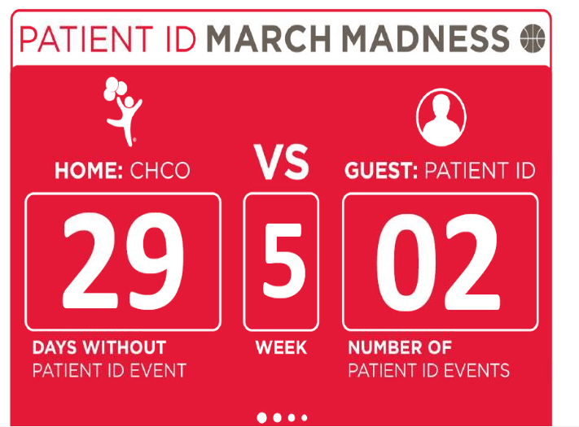
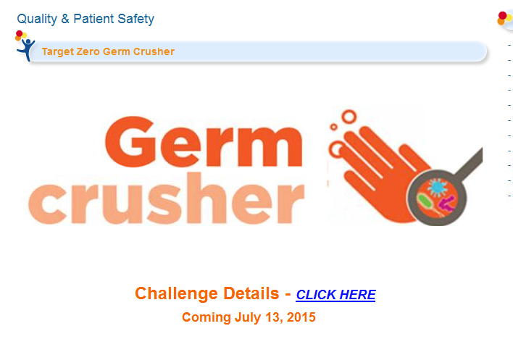
Notes:
Some examples of sequential interventions to continue reinforcing the changes, increasing impact and improving results.

Slide 51

Make it Stick
Devil’s Thumb, Tabernash, CO
Notes:
Actions for making it stick/Institutionalize new approaches
Articulate connections between new behaviors and corporate success.
Create leadership development and succession plans consistent with the new approach.
Pitfalls
Not creating new social norms and shared values consistent with changes

Slide 52
Cultural change comes last, not first
You must be able to prove that the new way is superior to the old
The success must be visible and well communicated
Reinforce the culture with every new employee
Make it as easy as possible to do the right thing
Institutionalize new approaches

Slide 53
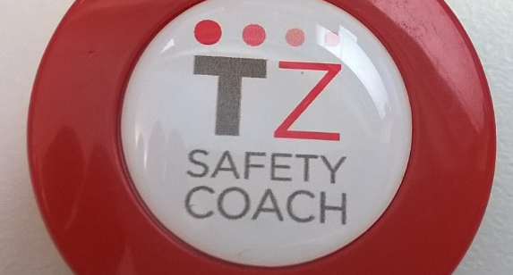


Notes:
Sustainable changes in the system will hard wire the behaviors and processes that led to the improvement and permit it to sustain

Slide 54
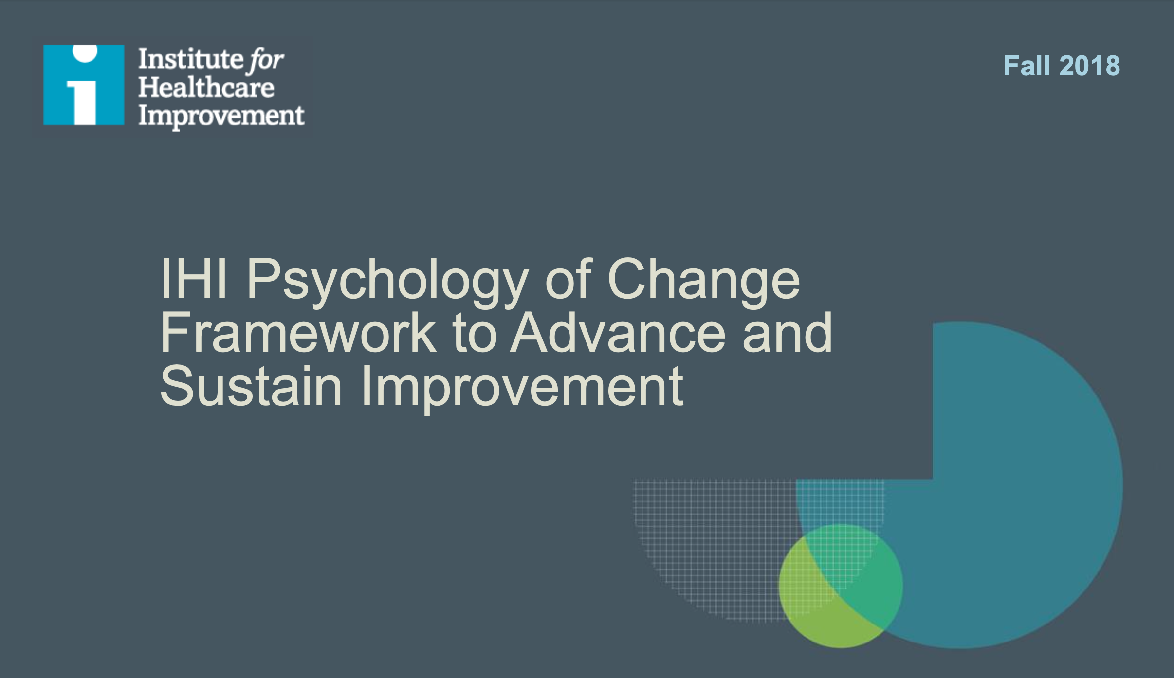

Slide 55
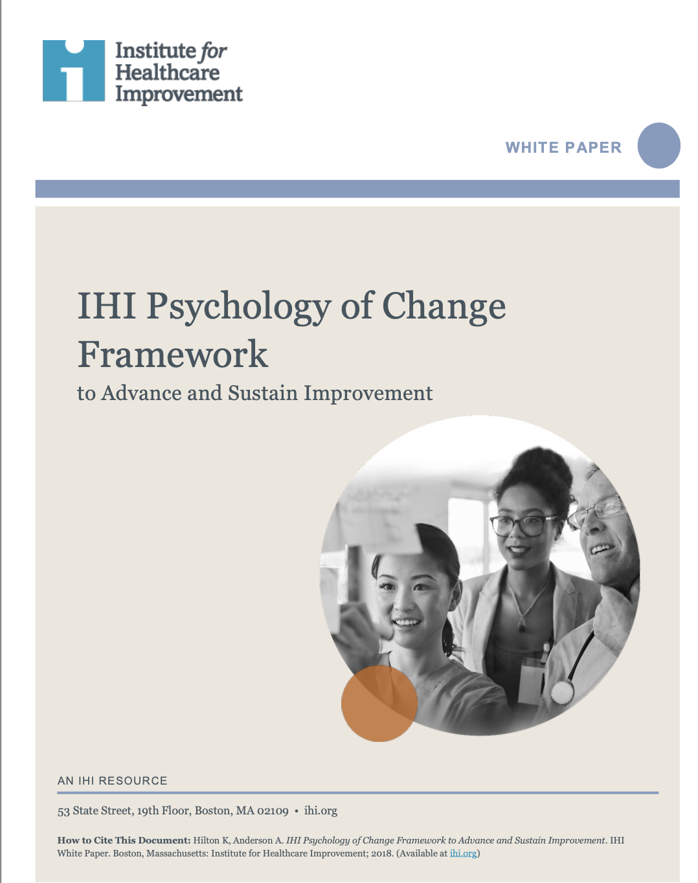
Hilton K, Anderson A. IHI Psychology of Change Framework to Advance and Sustain Improvement. IHI
White Paper. Boston, Massachusetts: Institute for Healthcare Improvement; 2018. (Available at ihi.org)

Slide 56
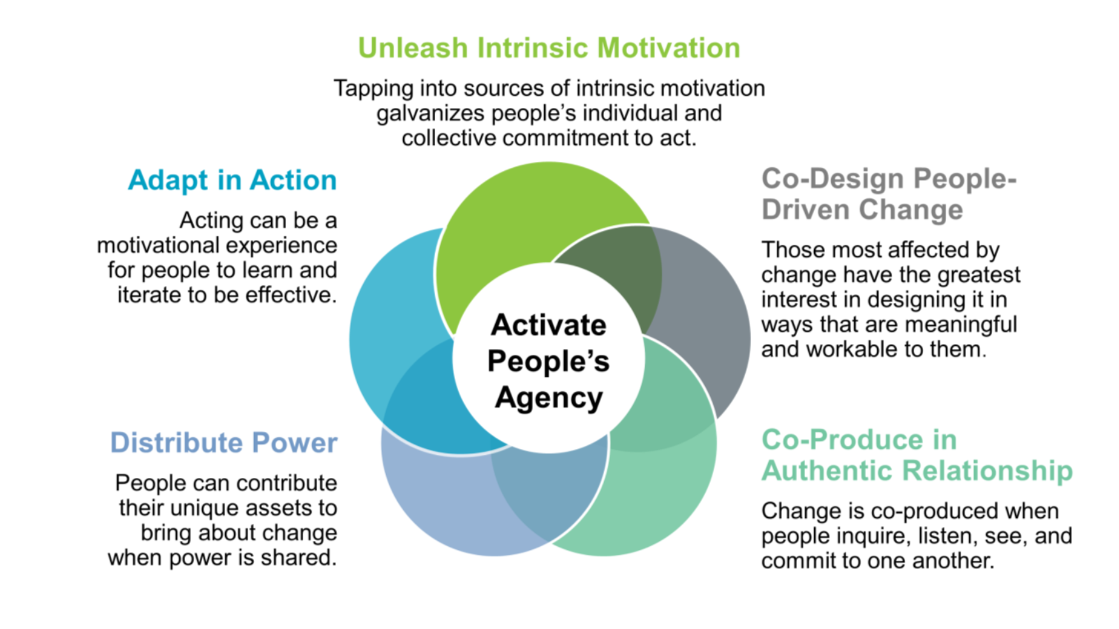
Notes:
The IHI Change model has five components especially geared to the human side of change- it has at its core the idea that change happens because of people’s engagement in that change and their own agency to accomplish change and realize their goals.
The five components are:
Unleash intrinsic motivation (closely aligned with creating urgency in Kotter)
Co-design people driven change and Co-produce in authentic relationships speak to the way we as leaders think about the role of our team members and our stakeholders and leaders organizationally-
Distributing power emphasizes that this can not be about the leader- it needs to be about the people who the change will benefit (And engaging them, the patients!) and the people making the changes.
Finally, adapt in action recognizes the need for PDSA type incremental changes and cycles of tests and assessment and pivoting to the next change.
-IHI’s model incorporates concepts from Kotter (e.g. both having a guiding coalition and engaging teams are reflected in co=design and co-produce) but it’s human centeredness is a nice complement to the Kotter model which is more linear and human elements are less explicit.. Other models may incorporate the natural resistance to change as an additional concept to consider- people don’t like change so we need to approach the need for change thoughtfully and be prepared to address resistance that may show up as questions, passive aggressiveness, failure to follow through on requests or follow new standards.
See below transcript from a prior IHI course- (I think this is too long and prefer the above distillation but let me know if you want to include some of the below I have glossed over or skipped.)
s
From ihi module previous
Improvement thought leader W. Edwards Deming stressed the importance of psychology, the adaptive human side of change, in his System of Profound Knowledge, in which he distilled the information and skills that can be brought to bear on any improvement into four interrelated areas: appreciation for a system, knowledge of variation, theory of knowledge, and psychology. In Deming’s view, psychology is the way people think and feel, what motivates them, and how they behave, including when they encounter change. Dr. Deming acknowledged that all improvement occurs in human systems in which people are the fundamental source of value, and that it takes work and expertise to create a culture that respects and motivates them. For improvement to succeed, he said, leaders need to understand the broad area of psychology. Recognizing the value of each person regardless of identity or position in an organization, the IHI Psychology of Change Framework emphasizes the ways the people affected by improvement can contribute to the solution. The central objective of the framework is to activate people’s agency. Agency is the ability of an individual or group to choose to act with purpose.
The framework is centered on activating agency at three levels. First, the level of self — an individual’s agency to make their free choices. Second, at an interpersonal level — the collective agency of people acting together. And third, at a system level — the structures that support the exercise of agency within and across organizations. Agency has two primary drivers: power, or the ability to act with purpose; and courage, or the emotional resources to choose to act in the face of difficulty or uncertainty. For example, Dr. Rose and his improvement team had a good idea about how to improve surgical safety, but their initial implementation strategy resulted in limited power, or ability to achieve the intended outcome. Their power was limited by people’s resistance to changing their behavior and dependent on people’s commitment to use the checklist. This kind of commitment requires courage, or the emotional conditions to choose to adopt the checklist. To advance their improvement work, Dr Rose and his team needed to identify ways to activate people’s agency, their power and courage, to result in the choice to use the checklist.
Let’s further define these terms. Here, we view power not as a position or a title that a person has within an organization. It’s not a trait. Power is relational. It is produced by interdependent relationships that can be altered to achieve a specified aim. Power is generated as people like Dr. Rose and his colleagues bring to bear their skills, knowledge, experience, and capacity to act individually and together to achieve an aim. As for courage, its Latin root is “cor,” or heart. Courage comes from people’s emotional for choice to act in the face of challenge. Educator Parker Palmer explains that the source of courage is in knowing ourselves, creating circumstances in which others can become more self-aware, and being in relationship with what is happening around us. Together, courage and power are the primary drivers to activate people’s agency. These drivers are, in turn, influenced by five interrelated domains of practice. The first domain is to Co-Design People-Driven Change. Those most effected by change have the greatest interest in designing it in ways that are meaningful to them. The second is to Co-Produce in Authentic Relationship, in which people create change together when they inquire, listen, and commit to one another. The third is to Distribute Power. People can contribute their unique assets to bring about change when power is shared. The fourth is to Unleash Intrinsic Motivation. Tapping into existing sources of motivation galvanizes people’s individual and collective commitment to act. The fifth domain is to Adapt in Action. Acting itself can motivate people to learn and iterate to be effective. These five domains are not sequential; rather, they are interrelated and can be engaged in any order. In combination, these tools enable us as improvement leaders to establish the conditions for people to exercise their power and courage to activate their agency. We will take up each one of these domains of practice in the five remaining lessons in this program. Those lessons will introduce you to high-leverage tools and methods that will serve as change ideas as you consider how to activate your people’s agency. You’re probably already using some of them, and we encourage you to build on those strengths while incorporating new methods into your repertoire.

Slide 57
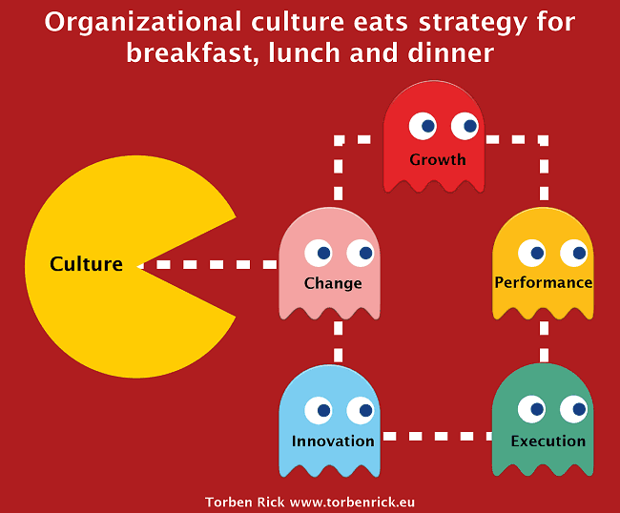
Barriers Challenges with Change

Slide 58
Anticipate it
Recognize it
Address it

Slide 59
Listening for “Resistance”
“I’m not sure/I don’t think this will work here”
“This will slow me down”
“This is not safe”
“We tried this before, it didn’t work”
“This is not my job/my responsibility”
”I am not in agreement with this change”
Signs of Resistance
“Strategic reservation”
Experience bias
Active dissent
Workflow protection
Ownership gap
Notes:
Since this is for the COPIC keynote and your audience consists of clinical teams working on improvement grants, the "clinical psychology" list you found is definitely the wrong vibe. Clinical teams deal with diagnosis all day; the last thing they want is to feel like they are being "diagnosed" with paranoia or nostalgia for having concerns about a project.
For a keynote aimed at busy healthcare professionals, you want terms that describe operational friction rather than personality flaws.
Here is how we can refine that list to feel more like "Leadership Observations" and less like "Psychiatric Evaluations":
5 Manifestations of Resistance in Clinical Teams
1. The "Wait and See" (Hedging & Passivity)
In a hospital setting, this is the most common form of resistance. Teams are already overstretched, so they conserve energy by not committing to a new initiative until they are certain it won't be "gone in six months."
The Look: Silence in meetings, delayed data entry, and "forgetting" to use new checklists.
The Keynote Pivot: Frame this as Conservation of Energy. They aren't being lazy; they are protecting their bandwidth.
2. Clinical Exceptionism (Segmentation)
The belief that "This might work for the ICU, but our clinic is different."
The Look: Adopting the parts of the change that are easy while keeping "shadow systems" (like paper workarounds) for the parts they feel don't fit their unique workflow.
The Keynote Pivot: Call this Workflow Protectionism. Acknowledge that their expertise makes them protective of what they know works for their patients.
3. The "Good Old Days" Shield (Nostalgia)
Using historical success as a reason to avoid future improvement.
The Look: "We've always done it this way and our outcomes have been fine."
The Keynote Pivot: Frame this as Legacy Pride. Use it to bridge the gap: "We are taking the values of the 'Good Old Days' and updating the tools to match."
4. Technical Distancing (Disassociation)
When teams feel the change is "top-down," they stop taking ownership.
The Look: "Just tell me what button to push." They stop using their clinical judgment to make the process better and simply follow instructions like robots.
The Keynote Pivot: This is a loss of Agency. In your talk, this is where you can emphasize the "Guiding Coalition"—bringing them back into the design process so they aren't just "end-users."
5. Vocal Skepticism (Revolt)
The "Disruptors" who openly challenge the aim or the vision.
The Look: Pointing out every flaw in the data or the SMART aim during a presentation.
trategic PreservationConserving bandwidth until the project proves its "staying power.
Workflow ProtectionismProtecting a localized process that they trust more than your new one.
Experience BiasUsing past success as a defense mechanism against the risk of the unknown.
Ownership DeficitDisconnecting from the "Vision" to avoid the emotional toll of potential failure.
The Keynote Pivot: Call these people your "Unintentional Stress-Testers." If you can win over the person who is "revolting," they often become your strongest champions because they actually care enough to be loud.g
Why the "Clinical" List Fails
If you show a slide with the word "Paranoia" to a room of doctors and lawyers, you’ll lose them immediately. It implies they are irrational. In healthcare, "resistance" is often a rational response to a poorly communicated vision or a fear that patient safety might be compromised during the transition.
Re-labeling for the Slide Deck
If you’re putting these on a slide, here’s a quick translation:
Instead of...Try...ParanoiaRisk SensitivityPassivityEngagement GapSegmentationLocalized WorkaroundsNostalgiaExperience BiasRevoltActive Dissent
How does that feel for the flow of the talk? It seems to bridge that gap you mentioned earlier between the Vision (the "why") and the SMART aim (the "how").

Slide 60
Addressing common barriers to change
Asking Questions
Listening & Reflecting
Telling
Listen/Reflect: with empathy, demonstrate understanding
Ask Questions: about underlying concern; for suggestions/ideas; for how we can help team can adapt and improve outcomes
Tell: explain the change and why
Note that people are sometimes more concerned about the transition than the new future state- address that!
Notes:
Explain the change and why it is happening (logic, vision)
State your concerns and observations
Reiterate the rationale for the change

Slide 61

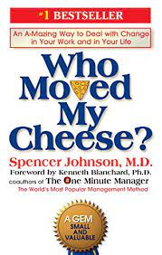


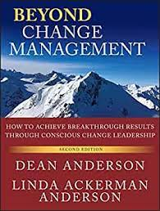
Resources and q&A

Slide 62
Leading Change in our Changing World
What kinds of things might change as our projects unfold that we need to account for?
Turn and Talk for 1 minute.. Let’s generate a list

Slide 63
Leading Change in our Changing World
Changing AI capabilities
Changing financial drivers/priorities/payment models
Changing Regulatory/Policy environment
Change fatigue among staff/leaders in our organizations
Changing workforce
Changing patient/family expectations
Changes in data availability
Changing organizational/board priorities, leaders, stakeholders
Other?

Slide 64
Primary Drivers
Secondary Drivers
Potential Action Items
Key Driver Diagram
Global Aim/Vision:
SMART Aim:
Quarterly Reassessment:
What is different in our system now?
Do I need to make modifications do I need to make in my drivers and changes?
Consider: new AI capability, new key stakeholders, new financial drivers
And others….

Slide 65
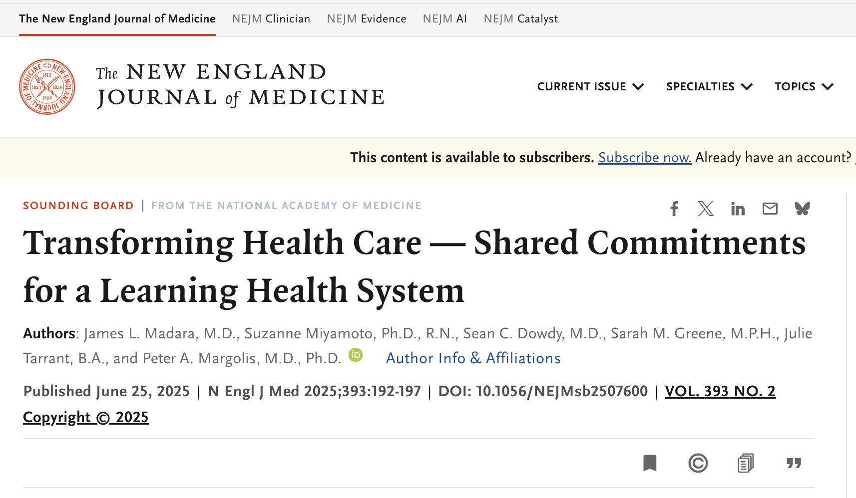

Slide 66
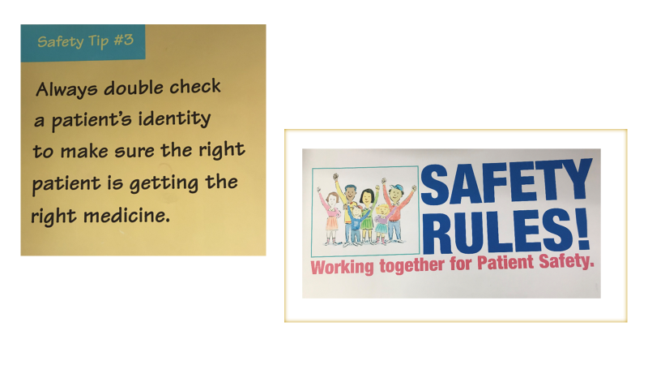
A few teachable experiences…
“Hey, Dan, why to you think “Target Zero” was so successful?
“Hey, Dan, why was “Safety Rules” a complete failure?”
“Hey, Dan, tell me how you would coach a team just starting out on its journey, what are the key things to know/do?”

Slide 67
Key learnings and Conclusions
Systemic change models can enable, accelerate and help sustain change- be rigorous in your methods!
Having senior leadership support for what you are doing is invaluable
Collaborate.-- identify your key stakeholders, make them see the benefit to them as well as patients/families
Engage patients/families in the change team
Be intentional about periodically assessing changes in the “System” over the life of your project

Slide 68
With apologies to “The Voice of a Generation”
Come gather ’round people
Wherever you lead
Let’s admit that the systems
We built are in need
Of our courage and Vision
In word and in deed
For our mission is truly worth saving
So let’s get to work
Let’s start planting the seeds
For the times they are a-changin’

Slide 69

Questions?
Kyoto, Japan

