Slide 1

Bear-RX PATHS
Copic Medical Foundation Grant
May 1, 2026

Slide 2
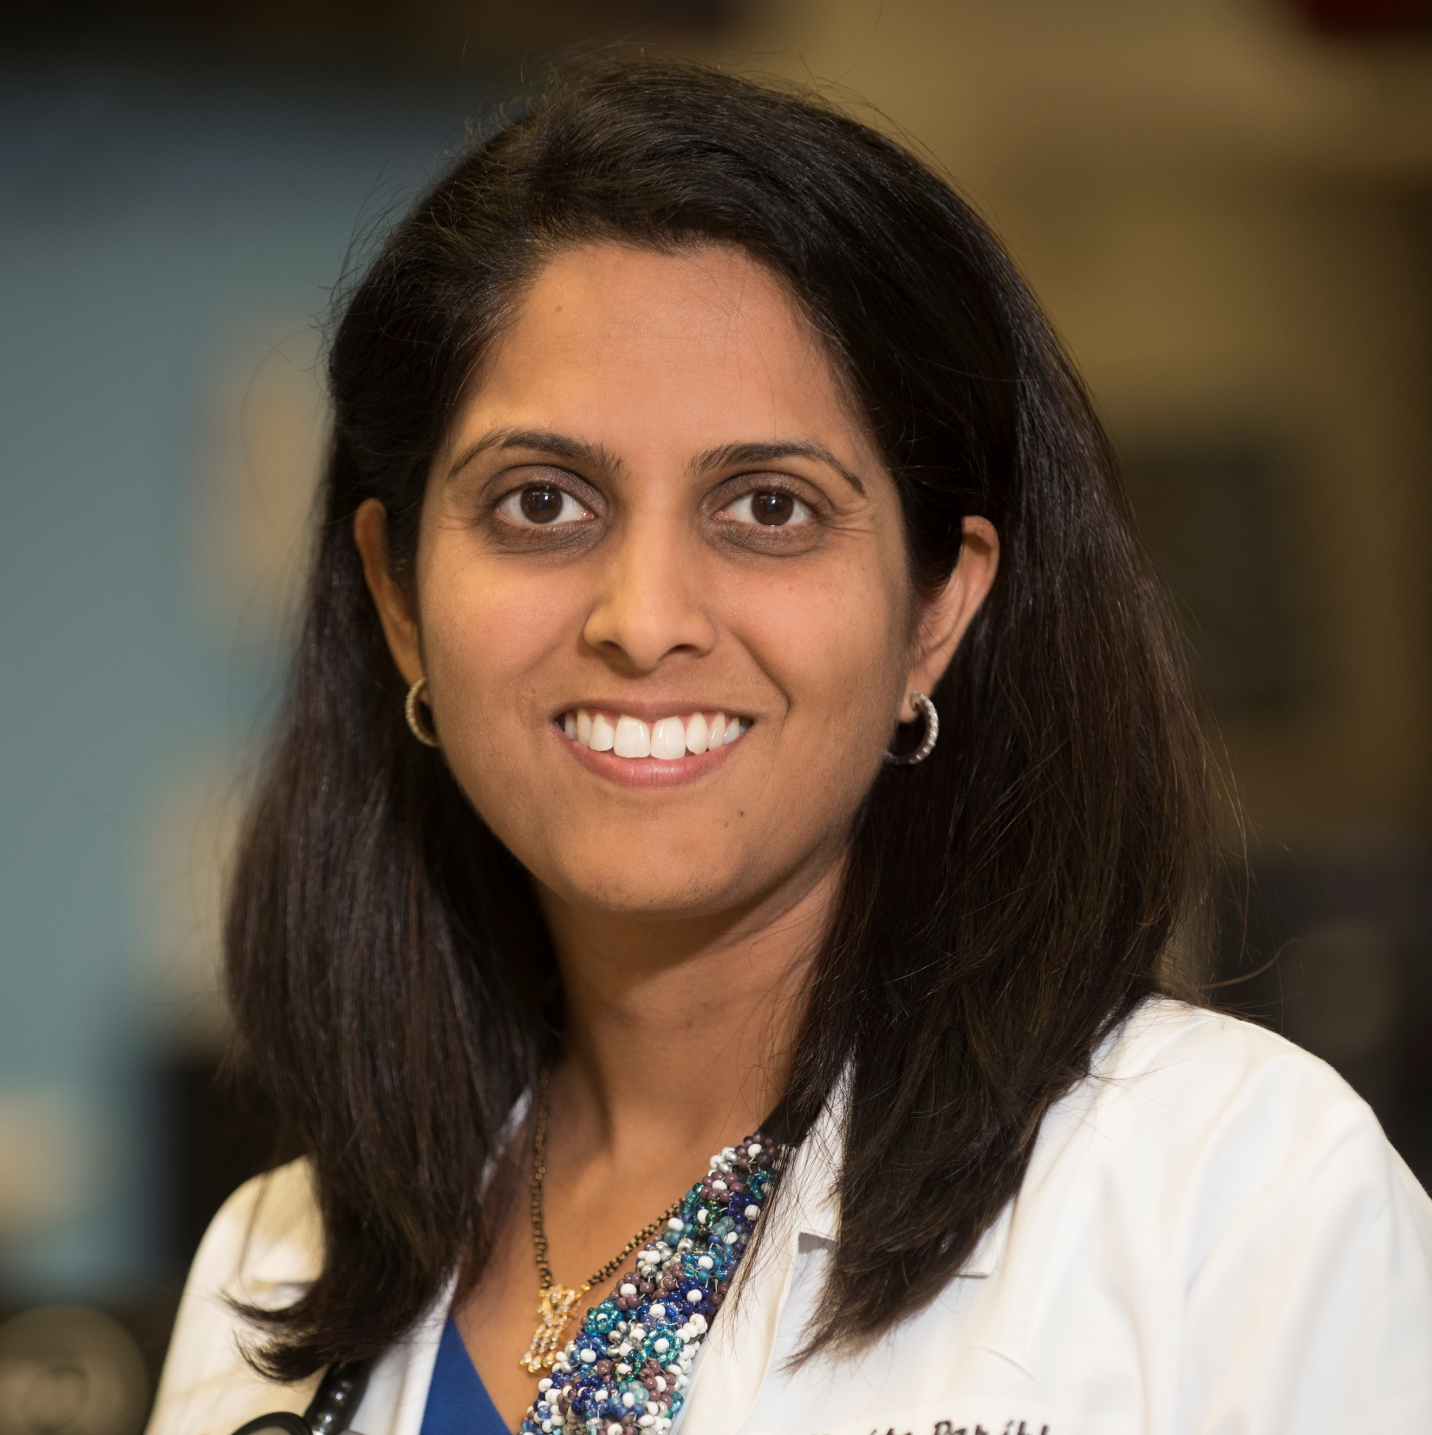
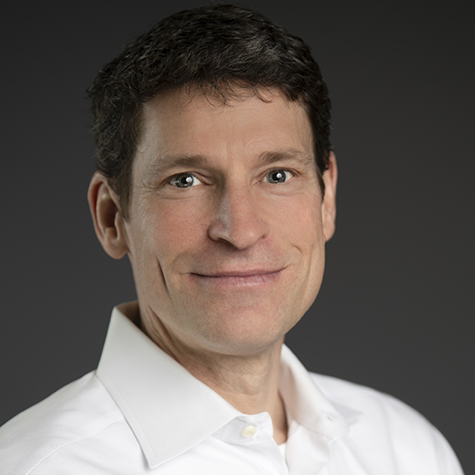
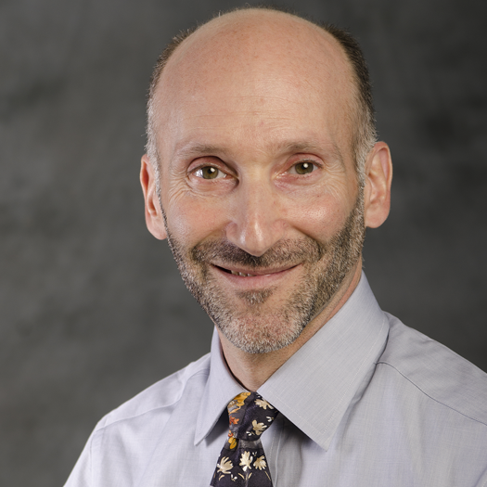
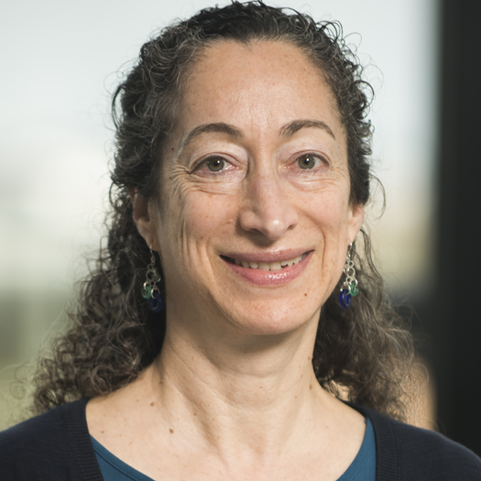
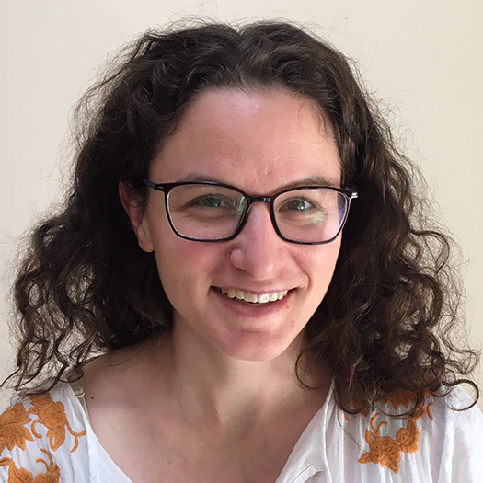
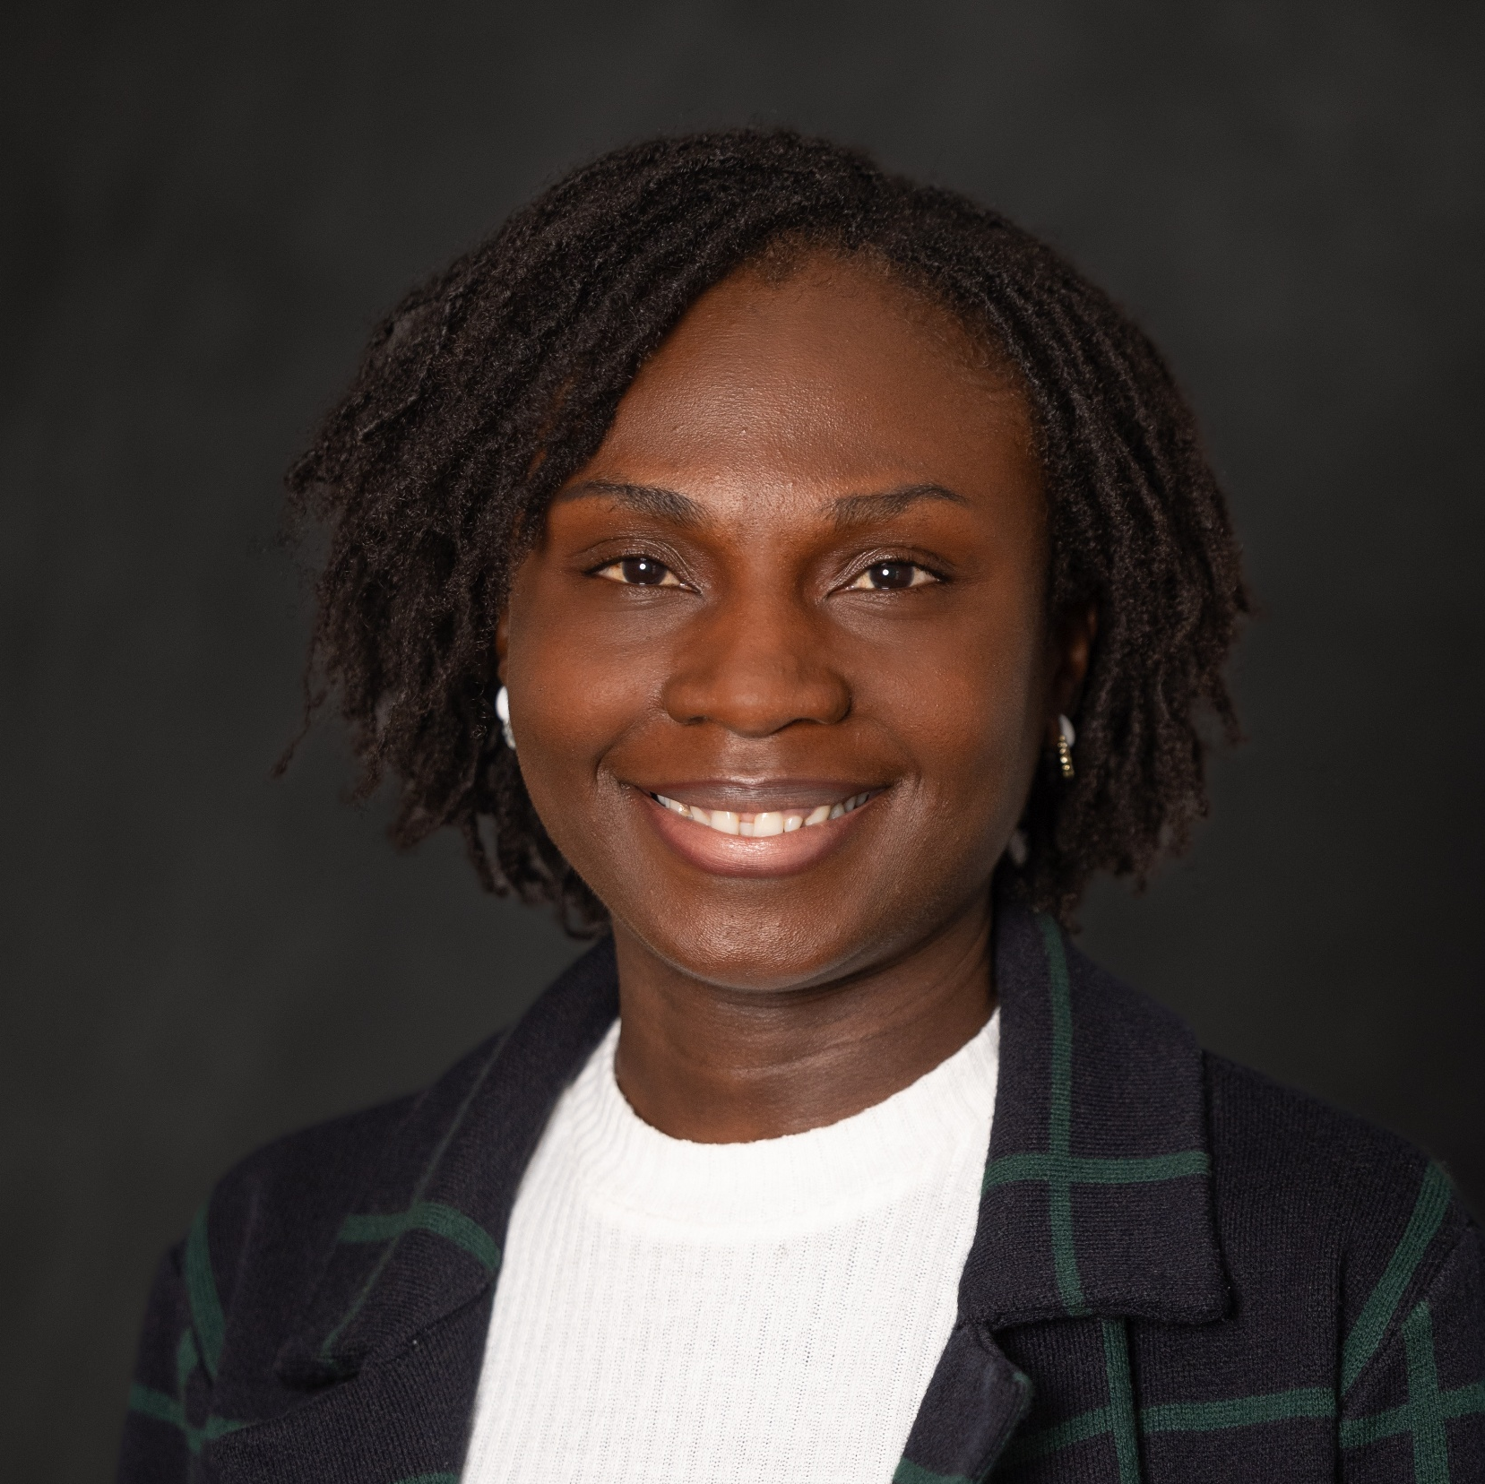
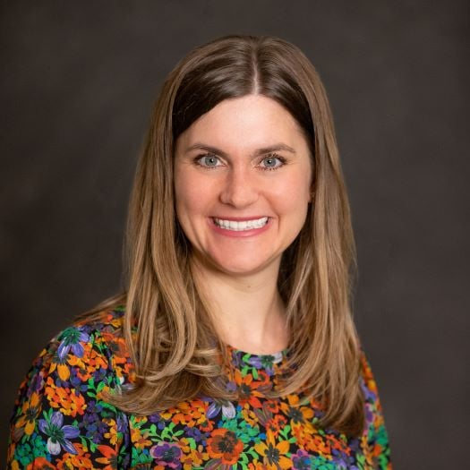
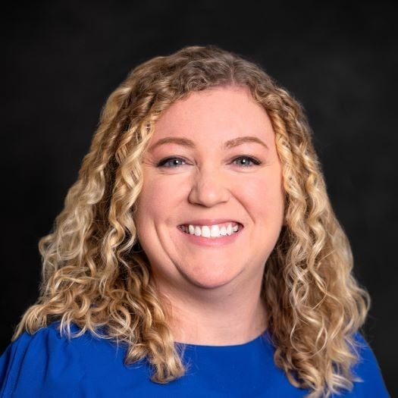
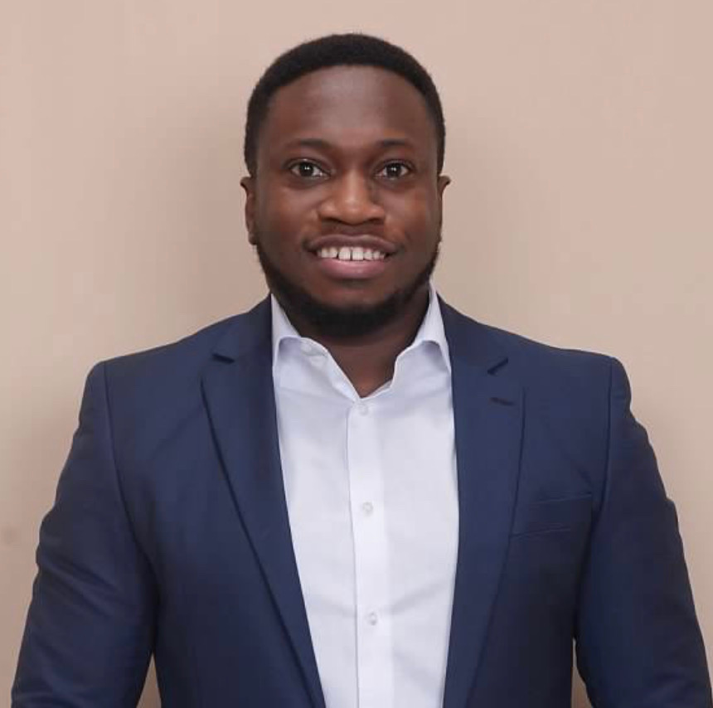
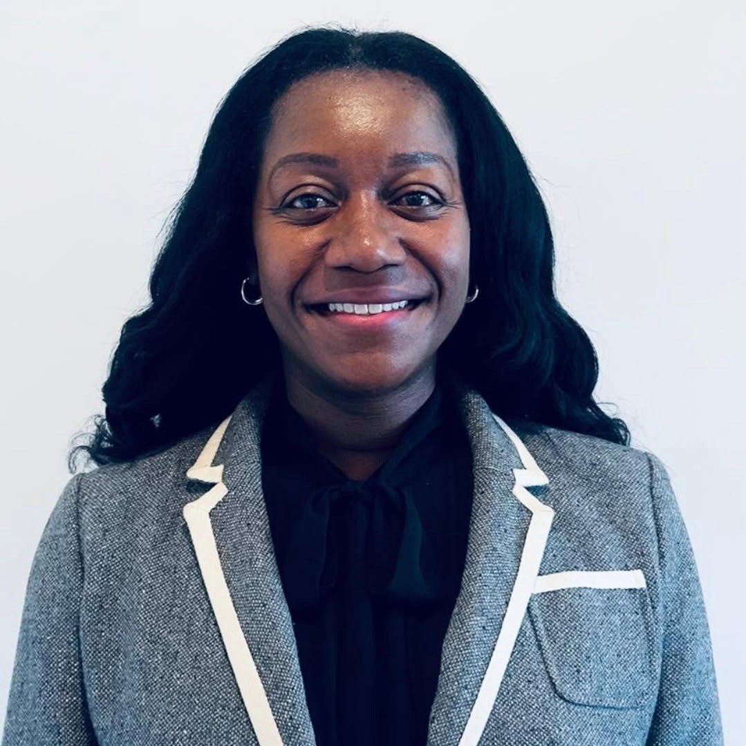
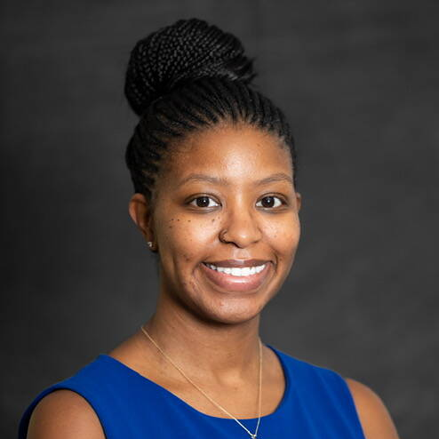
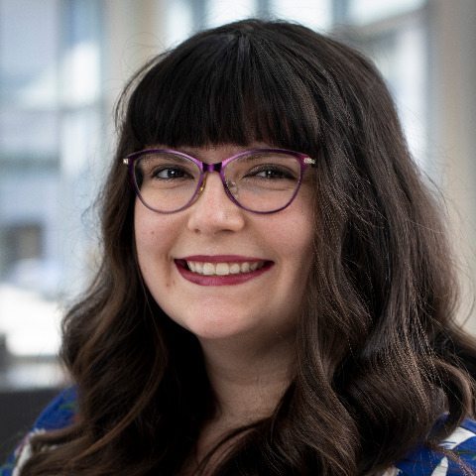

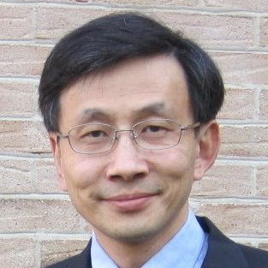
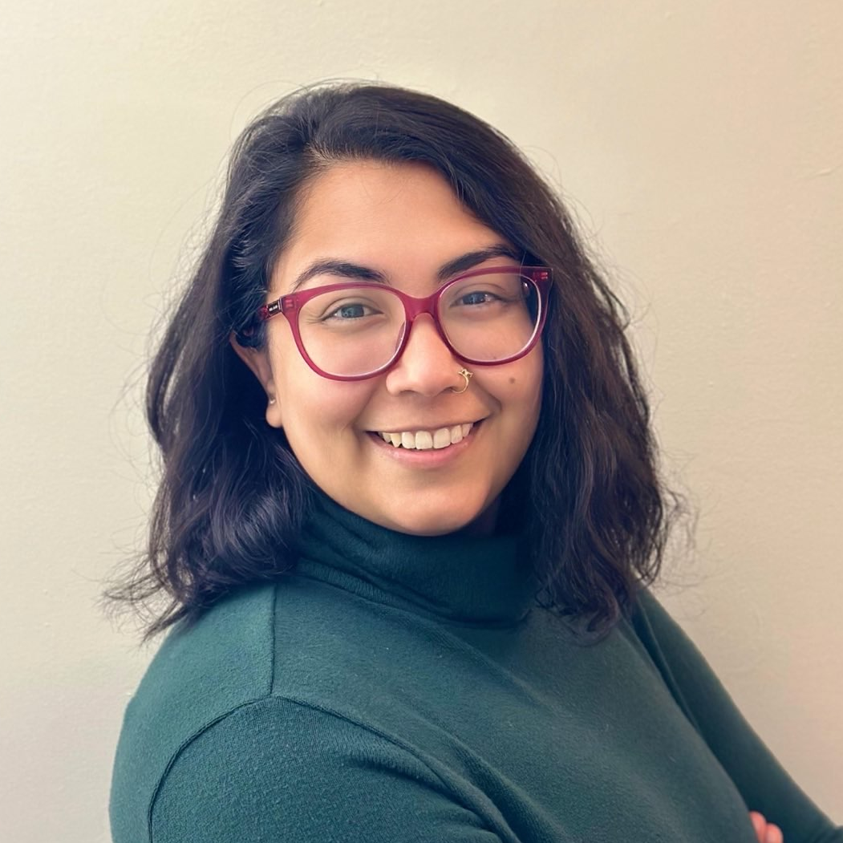
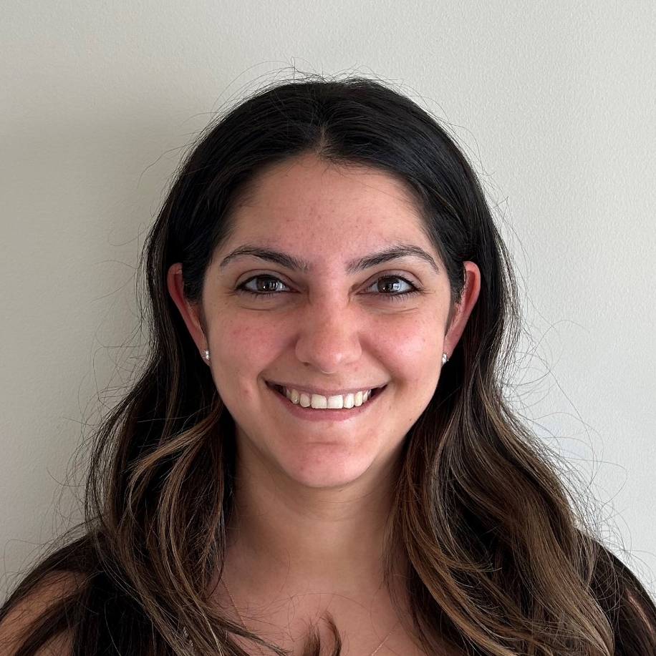
Study Team
Kavita Parikh, MD Principal Investigator
Craig DeWolfe, MD
Co-Investigator; Bear-PATHS Lead
Michael Lotke, MD
Complex Care Provider
Miriam Bloom, MD
Complex Care Provider
Nicola Brodie, MD
Complex Care Provider
Lauretta Oseni, MD
Complex Care Provider
Sara Rooney, PharmD
Pharmacy Team
Jessica Lundeen, PharmD
Pharmacy Team
Samuel Anti, PharmD
Pharmacy Team
Philomena Ebiasah, PharmD
Pharmacy Team
Erica Shepperd-Debnam, PharmD
Pharmacy Team
Billie Jo Mitchell, PharmD
Pharmacy Team
Darcel Jackson, CPXP
Family Partner
Jenhao Jacob Cheng, PhD
Clinical Statistician
anushka aqil, PhD, MPH
Project Manager
Amina Touma, SCRC
Project Manager

Slide 3

Bear-RX PATHS
Single Arm Feasibility Study
Hospital
Home
Admit to hospital
Screen eligibility
Consent caregiver
Visit 1
Visit 2
Bear-PATHS MD
Bear-RX PATHS Pharmacist A
Bear-RX PATHS Pharmacist B
1-7 days
4-6 weeks
Standard of care
Study Intervention
Study Intervention
Pharmacist will
Review medications
Review refills
Track medication errors
Provide recommendations to resolve medication issues
Outcome Measures
Feasibility*
Acceptability*
Errors/IRR

Slide 4
Study Timeline
May 2025 – September 2025:
Study Activation
Adding key stakeholders to study team, IRB preparation, creation and pilot testing of study tool
October 2025: Study Launch!
October 27, 2025 – present:
Active Enrollment
Enrollment of 18 families, 75+ medications reviewed

Slide 5
Study Participants (to date)
42 participants approached
Caregiver time constraints
Lack of interest
Unable to reach family
> 45%
19 participants consented
2 participants lost to follow-up
2 participant excluded
1 Visit 1 pending
14 participants completed V1
8 participants completed V2
2 participants completed one-on-one interview

Slide 6





Study Participants (to date)
Child’s Age Range
English / Spanish
2-17
14 / 5
Readmission Rate (within 30 days post-discharge)
Avg Number Discharge Meds
17.7
21.5%
Median Time to Readmission
7 Days
Notes:
Average Number of Meds: 17.7
Readmission Rate: 3/14 (21.5%)
*14 families who completed V1 – 4 families readmitted and did not complete V1
Readmission in 30 days, and median time to readmission.
Readmissions: 21, 6, 7 – median: 7

Slide 7
Age ​(yr)​ | Device​ | Admit & Medical Diagnoses​ | # Total Meds (standing/​prn)​
13​ | G-tube​ | Seizures​* Lennox-Gastaut syndrome, spastic quadriplegic, cerebral palsy, ​ intellectual disability​ | 19​ (14/5)​
17​ | None​ | Anemia, Hyperkalemia​ Duchenne muscular dystrophy,​ cardiomyopathy, adrenal insufficiency​ | 16​ (9/7)​
8​ | G-tube​ | Rhino/enterovirus, aspiration pneumonia​ Rett's syndrome, seizures​ | 13​ (13/0)​
8​ | G-J tube​ | Acute feeding intolerance* Autoinflammatory syndrome, ​autonomic neuropathy, ​ dysautonomia-like disorder​ | 42​ (33/9)​
6​ | None​ | Emesis, RSV, Flu*​ GERD, hydrocephalus,​ developmental delay, hypotonia, epilepsy, VP shunt​ | 15​ (7/8)​
3​ | G-tube​ | Respiratory failure, pneumonia ​ Hypotonia,​ status dystonicus, congenital methemoglobinemia​ | 16​ (13/3)​
13​ | G-J tube​ | Respiratory failure, dehydration​ Intractable epilepsy​ | 10​ (9/1)​
3​ | G-J tube​ | Respiratory failure​ Epilepsy, restrictive lung due to neuromuscular disease | 14​ (11/3)​
15​ | None | Parotitis​ Combined immunodeficiency disorder, congenital sucrase-isomaltase deficiency | 16​ (14/2)​
8​ | None​ | Hydration prior to OR procedure​ Chromosomal microdeletion syndrome, epilepsy, hydrocephalus​ | 27​ (25/2)​
13​ | G-tube​ | Respiratory failure ​ Epilepsy, cortical visual impairment, dysautonomia, spastic quadriplegia, ​cerebral palsy | 14​ (9/5)​
2​ | G-tube​ | Status Epilepticus​ Respiratory failure, Lowe syndrome, hypernatremia, development delay,​ dysphagia​ | 11​ (11/0)​
*: indicates re-admission within 30-days

Slide 8


Feasibility Snapshot
Visit 1 (n=14)
Visit 2 (n=8)
# V1Completed/
# Consented
Avg Length of Visit
# V2 Completed /
# V2 Eligible
Avg Length of Visit
14/19 = 73.7%
46.6 minutes
8/9 = 88.9%
46.5 minutes
% of Total Meds Reviewed
Avg # of Meds Reviewed
% of Total Meds Reviewed
Avg # of Meds Reviewed
40.8%
6.9
45.4%
8.6
Pharmacist + BearPATHS provider
Pharmacist Only

Slide 9
Care Team Acceptability
Pharmacy Team (n=10)
Provider Team (n=4)

Slide 10
Caregiver Acceptability
V1 (n=12) V2 (n=8) | The pharmacist helped me feel more confident giving medications at home |  | The telehealth visit addressed my biggest concerns about medications |  | I would recommend this kind of telehealth follow-up to other families
 | V1 | V2 | V1 | V2 | V1 | V2
Strongly Agree | 3 | 4 | 5 | 4 | 7 | 6
Agree | 6 | 2 | 4 | 2 | 2 | 2
Neutral | 3 | 2 | 2 | 2 | 3 | 0
Disagree | 0 | 0 | 1 | 0 | 0 | 0

Slide 11
Qualitative Caregiver Feedback: Developing Themes
Discharge Preparedness
Supports confidence building
Balance of high cognitive load right after discharge
Role of Pharmacist
Reassurance
Safety & Error Prevention
Preventative
Immediate discrepancy identification
Feasibility & Burden
System Navigation & Continuity
Safety net
Error detection
High acceptability
Need more flexibility, especially with complex cases
Opportunities to develop systems to reduce caregiver burden (e.g., portable documentation for primary provider)
Notes:
Developing themes
Discharge Preparedness
Feasibility and Burden
System Navigation and Continuity

Slide 12
Qualitative Caregiver Feedback (n=3)
“We had a couple of minor mistakes on my end, and we were able to spot that and get that corrected. If it was one of these other medications… then absolutely… it could save a trip to the ED.”
“Sometimes you don’t really understand what the medication does, even after it’s explained at discharge. Once you’re home, that really helps.”
“I would recommend it… especially if they’re walking away with 7 or more medications”
Caregiver one-on-one interviews, BEAR-Rx PATHS
Notes:
Darcel

Slide 13
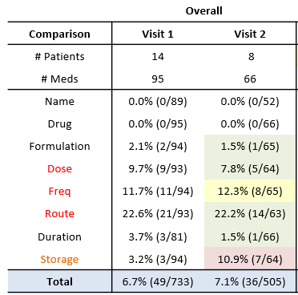
Medication Errors
 | Total Meds Reviewed | # of Errors
Visit 1 (n=12) | 95 | 39 (41.1%)
Visit 2 (n=6) | 66 | 28 (42.4%)

Slide 14
Our Learnings
Structure: Setting, Resources, Population
High clinical complexity – high # meds and risk of readmission
Caregiver demand – interesting and perceived value
Positive feedback from Pharmacy and Bear-Paths provider
Process: Implementation and Delivery
Visit burden – too long
Integration with primary care vs discharge team
Optional vs required
Caregivers want flexibility to schedule after discharge
Outcomes: Value and Impact
Positive Caregiver Acceptability and Feasibility from surveys
Positive Caregiver Feedback from qualitative interviews
Strong IRR with medication review tool
High rate of medication errors in the home after discharge
Notes:
PRN vs Standing Meds

Slide 15
Sustainability Ideas
Clinical Space
(Complex Care & Specialty Clinic)
Payor Space (HSCSN)
Specialty Pharmacy
Subacute Rehabilitation Hospital (New Hospital Setting)
Notes:
Added perk of specialty pharmacy.
Complex Care Team – Billlie had meeting last week
Explore with DC Medicaid – reduce meds? Less cost for payor
HSCSN opportunites – Paul Manicone?
PHN – Dr. Fox – any payors around medication safety, and VBC angle.
Talk with Miriam
Add to multidiscpliniary clinics – cardiac meds
Not just # meds, but risk profile. Cardiac medication issues.
Enroll with initiation of meds.
Risk profile of meds with pharmacy team.

Slide 16
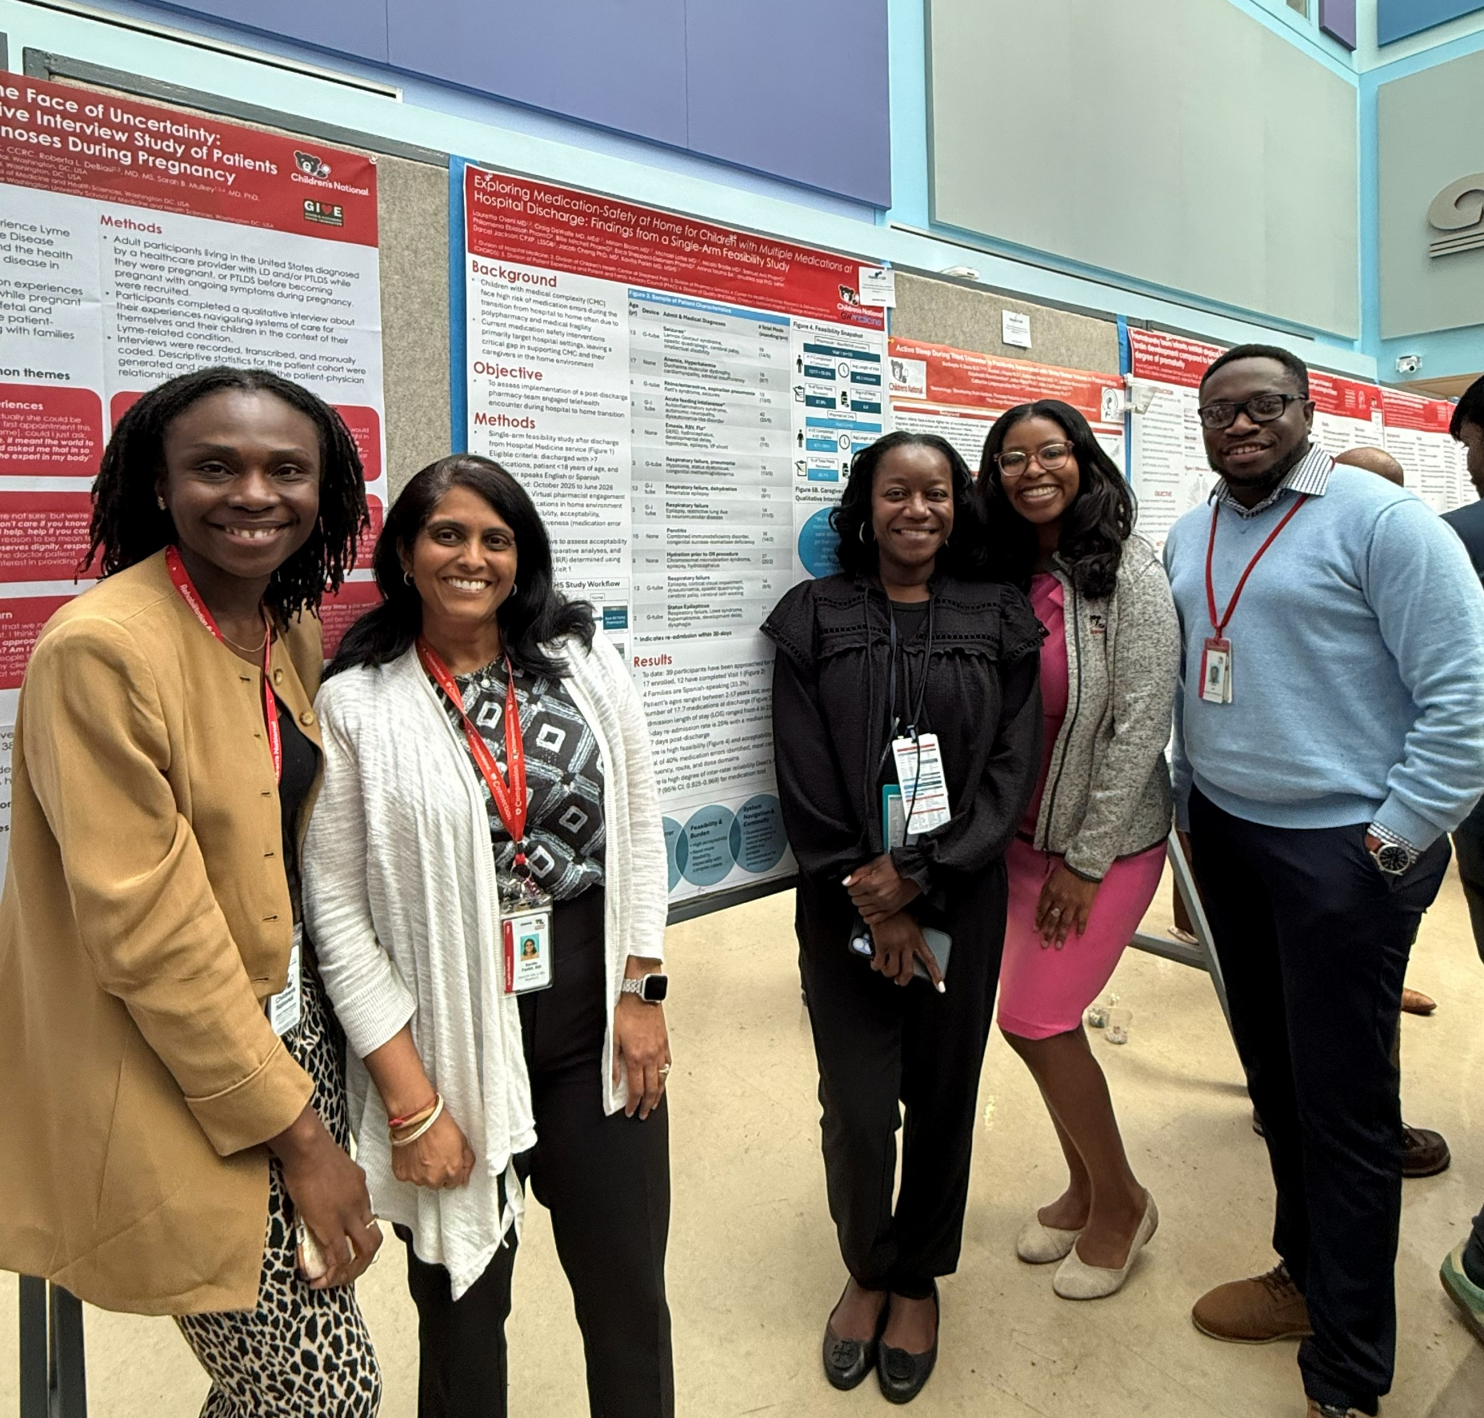
Dissemination Opportunities
Local Presentations
  Children’s National Research Institute’s Research,
  Education & Innovation Week: April 2026
  Children’s National Hospital Patient & Family Experience
  Week: April 2026
  Hospital Medicine Research Compendium: June 2026
National Conferences
  Pediatric Hospital Medicine (PHM): August 2026 (Kansas City)
  American College of Clinical Pharmacy: October 2026 (Salt Lake City)
  American Academy of Pediatrics: October 2026 (San Diego)
  Pediatric Complex Care Association (PCCA): October 2026 (Cincinnati)
  Planetree’s Person-Centered Care Global Forum: October 2026 (Boston)
Manuscript Drafted

Slide 17
Thank you!

