Slide 1


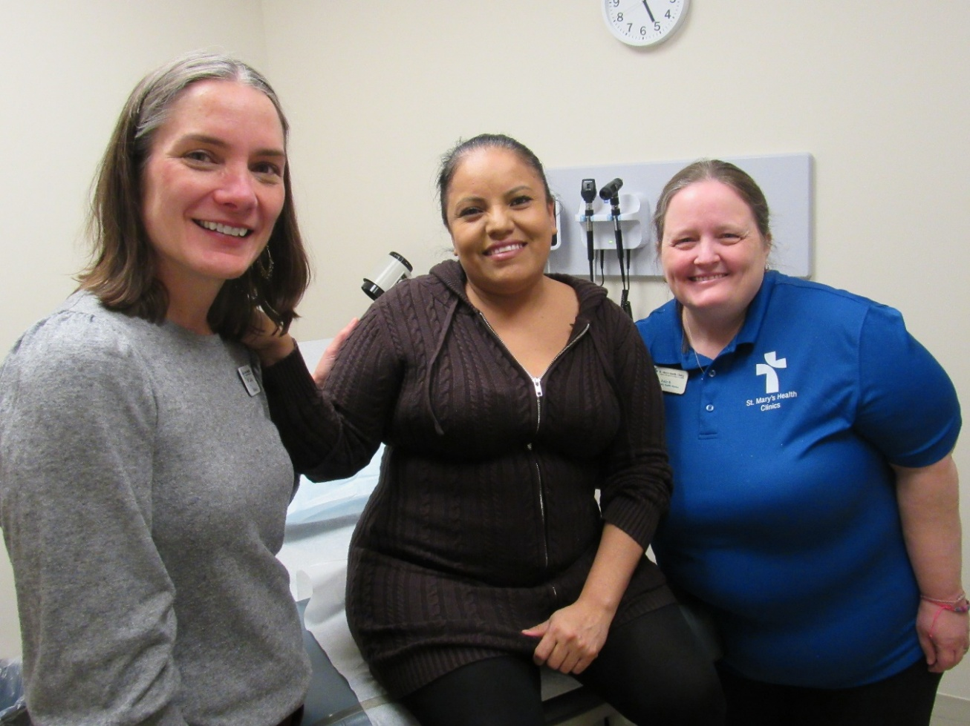
St. Mary’s Health Clinics
MISSION:
In the tradition of the Sisters of St. Joseph of Carondelet,
St. Mary’s Health Clinics (SMHC) will carry out the healing ministry of Christ by providing necessary
and accessible health services to the medically
uninusured and underserved.
VISION:
Affordable, accessible, quality healthcare is available to all individuals.

Slide 2

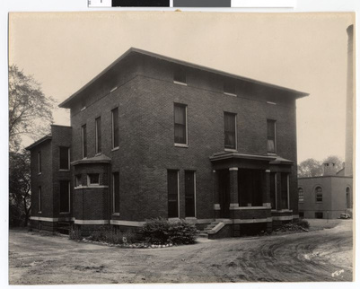

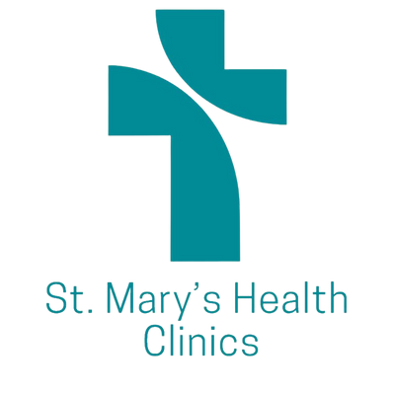
St. Mary’s Health Clinics
1851
1853
1990
1991
1992
2002
2012
TODAY
4 pioneer Sisters of St. Joseph of Carondelet arrived by riverboat in St. Paul to establish a mission on the banks of the Mississippi River.
The Sisters’ impact expanded quickly when a deadly Cholera epidemic broke out. They converted their log cabin schoolhouse into a makeshift hospital that became St. Joseph Hospital in St. Paul.
The CSJs operated hospitals in MN for more than 130 years. BY 1990, the sisters in MN decided to leave the hospital business but noticed that many hard-working people didn’t have access to affordable health care.
The sale of St. Mary’s Hospital in Minneapolis in December provided the funding needed for the Sisters to “return to their roots” and begin a new chapter of healthcare ministry: St. Mary’s Health Clinics (SMHC).
SMHC began! 5 clinics opened
31 doctors and 22 nurses volunteered to staff its clinics.
SMHC added
Latino Outreach Program
SMHC partnered with the Mexican Consulate to offer education and referrals through the Ventanilla de Salud (VDS)
6 clinics in
St. Paul, Minneapolis, Brooklyn Park. Apple Valley and Shakopee. Includes 150+ nurses, providers, interpreters, admission staff, and drivers who volunteer at the clinics.

Slide 3
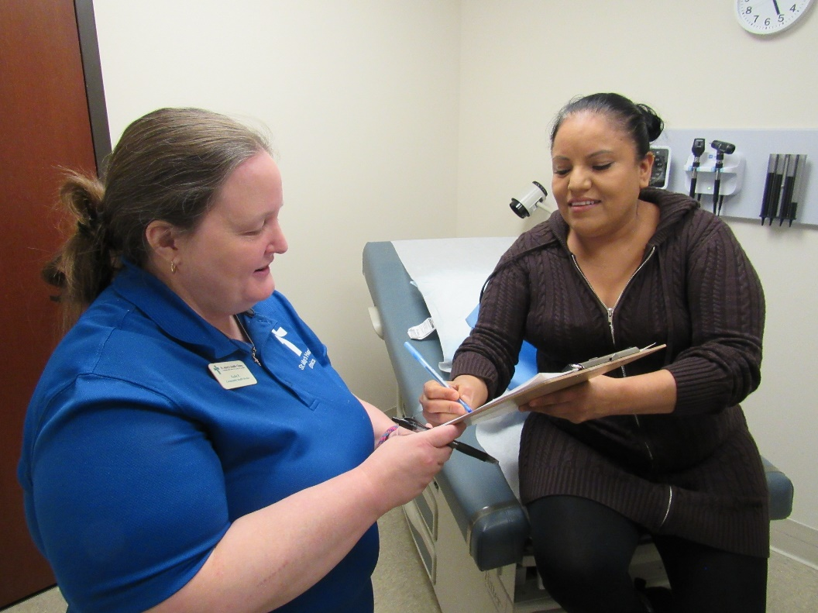
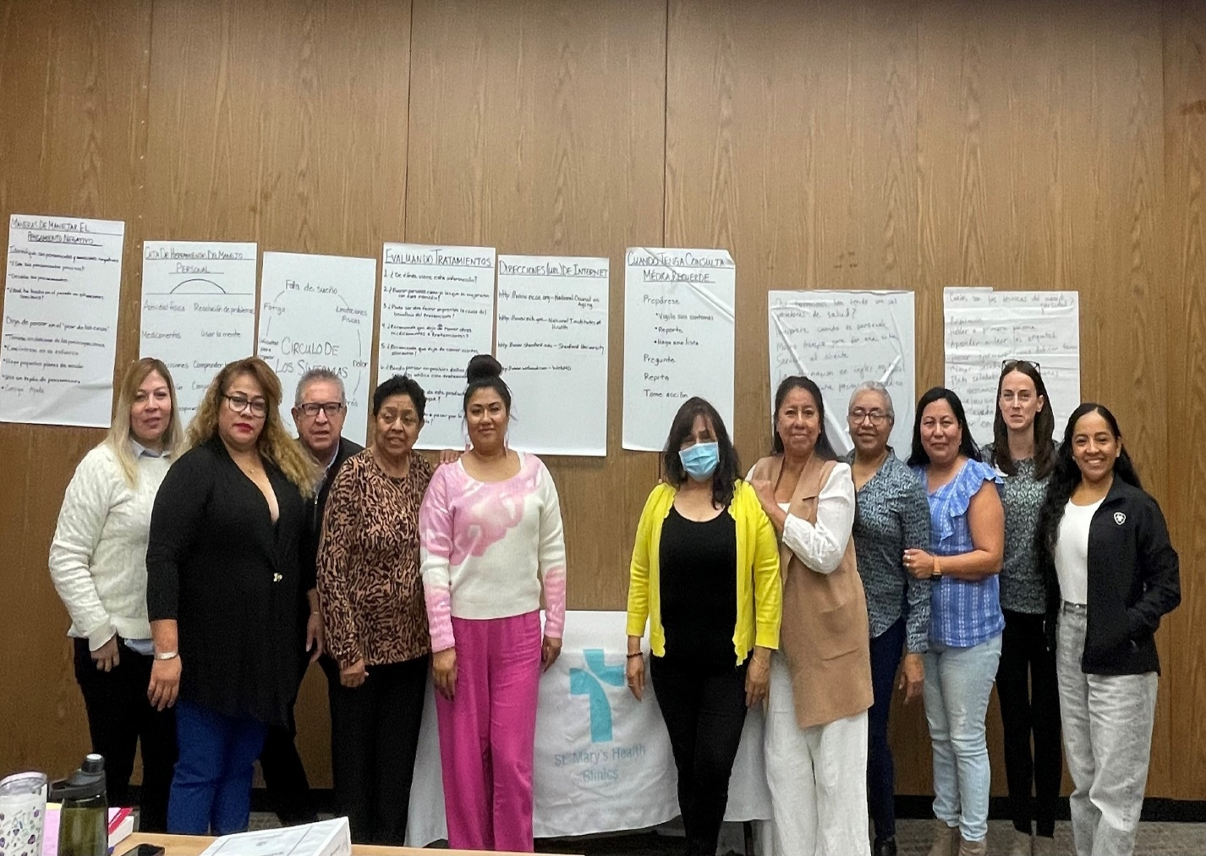
COMMUNITY HEALTH WORKERS
COMMUNITY HEALTH EMPOWERMENT INITIATIVE —
CULTURALLY TAILORED CHRONIC DISEASE MANAGEMENT AND PREVENTION
Streamline Care Coordination to address health care fragmentation
Improve health equity by addressing systemic barriers such as language, transportation and cultural competence.
Intentional work addressing hypertension, diabetes, prediabetes and high cholesterol.
Patient Support and Advocacy – Addressing Social Determinants of Health
Cultural mediation to improve trust and communication
Health Education and Patient support
Enhance Medication adherence
Community Outreach – health education, screenings, and referrals

Slide 4

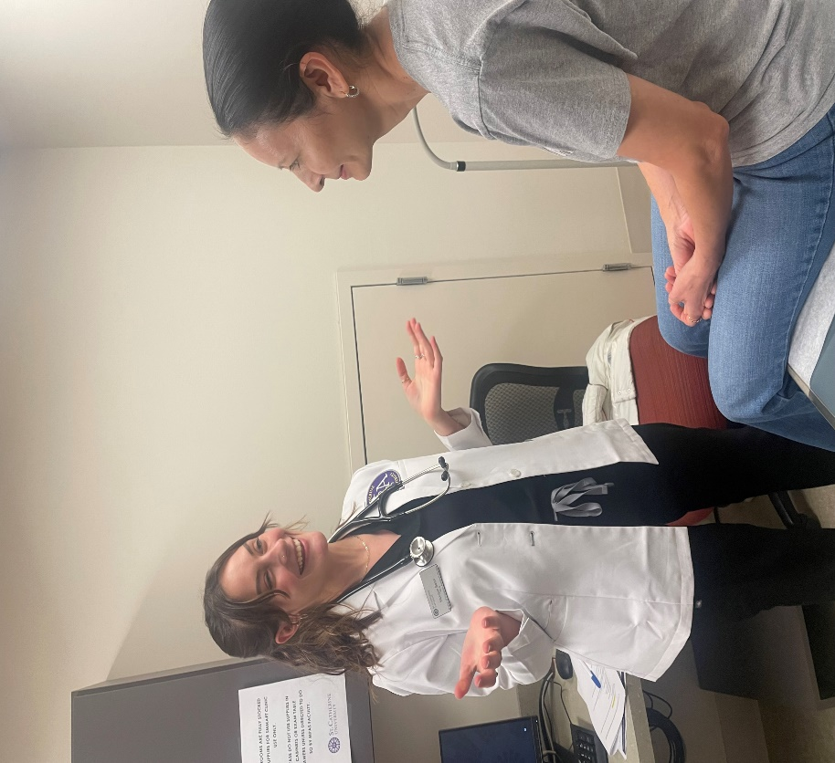
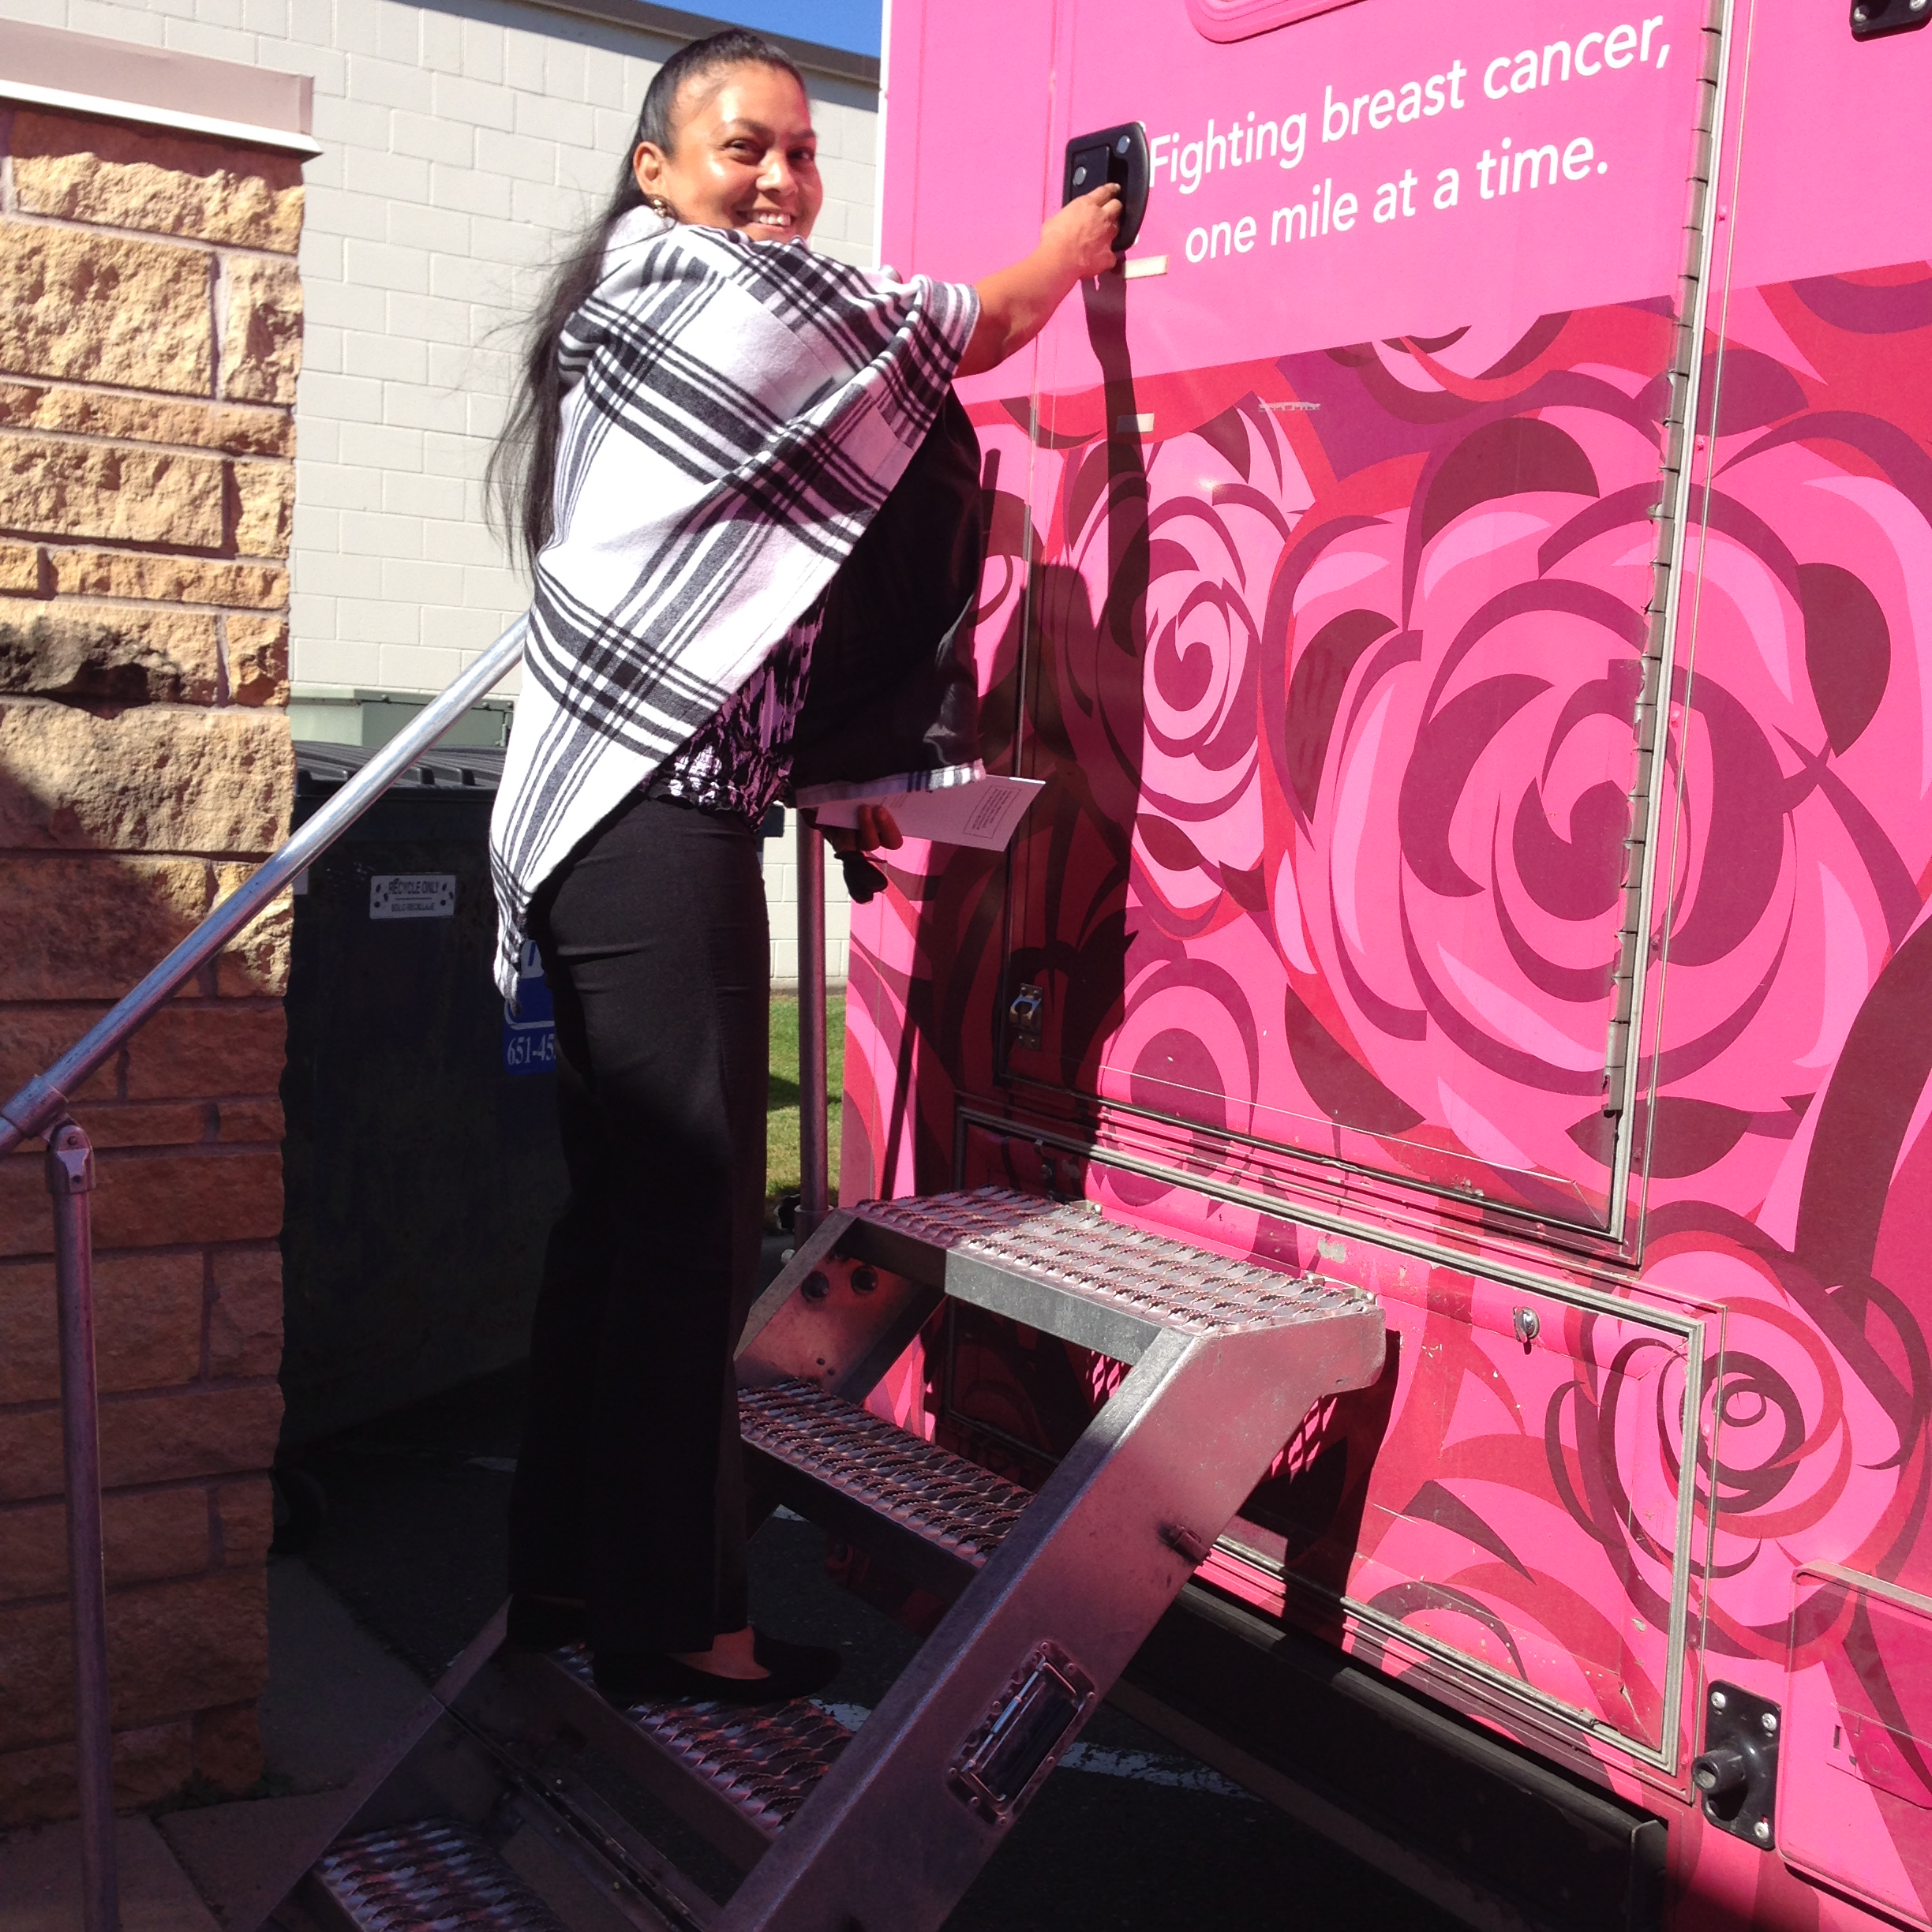
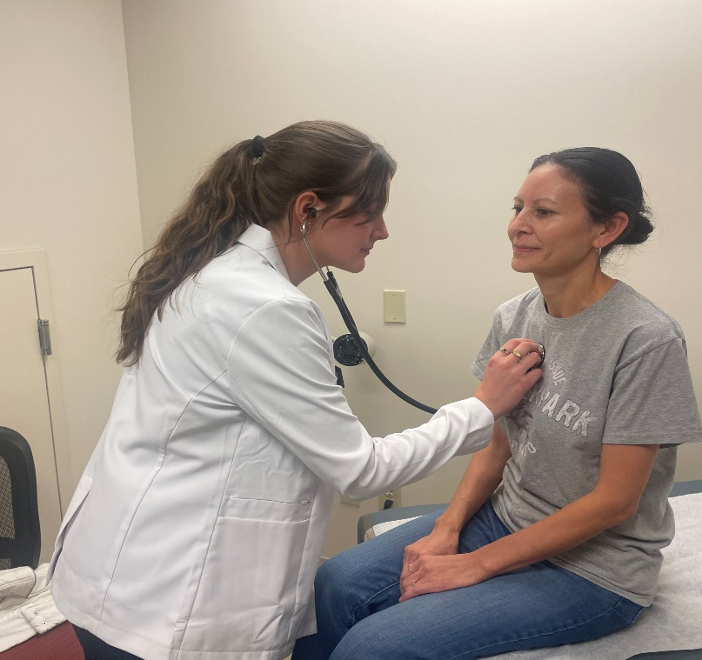
PRIMARY CARE CLINIC at no cost to the patient
EACH CLINIC TEAM COORDINATED BY RN/CHW PARTNERSHIP
Data from April 2025- March 2026
10 half day sessions/wk
staffed by volunteer doctors, nurses, and support staff
28 employed staff
8 Community Health Workers
4,932 patient visits
1,040 clinic patients
No Show rate: 3.8%
Cancellation rate: 4.1%
11% Virtual visits
Primarily Latino (99%)
St. Paul
Minneapolis
Shakopee
Apple Valley
Brooklyn Park
St. Catherine University
Mental Health- individual and group sessions
Specialty Referrals
Medications
Dental Referrals
Nutrition
OT/PT
CHWs:
2,021 one on one in person encounters (978 patients)
8,931 phone conversations
Group support education – skill development

Slide 5
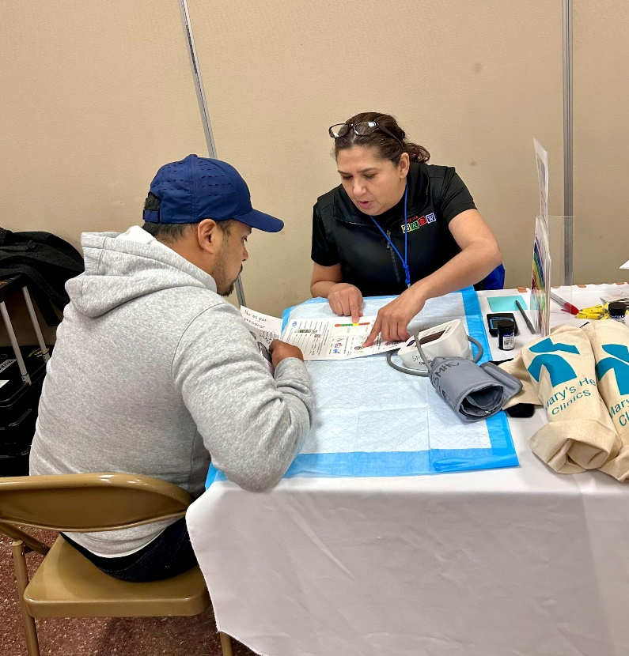
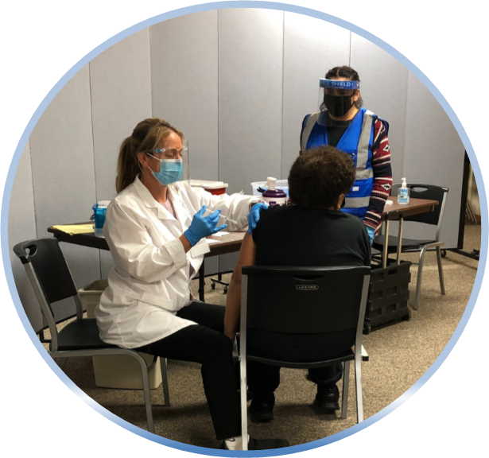
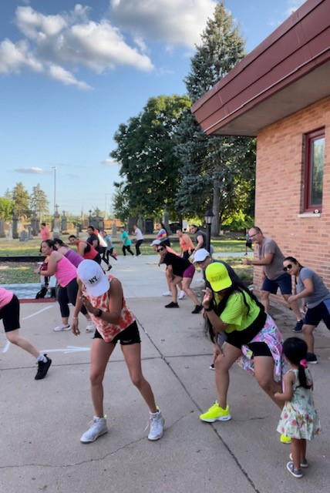
OUTREACH
Data from January 2025 – December 2025
Partnerships with Latino churches, schools and community agencies
Mexican Consulate and Ventanilla de Salud
Ecuadorian Consulate
Some outstate events
In person Education and Prevention
Screenings
HTN: 3,897
Glucose: 3,838
Connections to Resources
Coordination of 92 Vax clinics
148 Zumba classes
4 Sport Physicals clinics, (54 children)
Dental Varnish: 579
Community Health Fairs
Mammogram events
Emergency Financial Assistance
Agencies Collaborations for education and services

Slide 6











COMMUNITY PARTNERS
Demoret Stiftung Foundation

Slide 7


