Slide 1
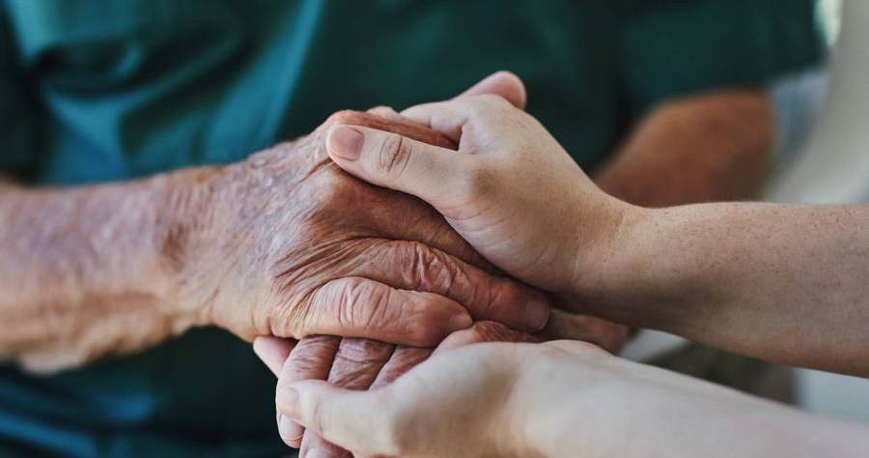
HWC/COPIC
Jimmy Ramsey​​
Notes:
Good morning and thank you for the opportunity to speak with you today.
My name is Jimmy Ramsey, and I represent Stigler Health and Wellness Center.

Slide 2

About hwc
Largest rural Community Health Center in OK
30,000 patient lives
9 clinical sites
Medical, Dental, BH, Optometry, Pharmacy, SUD
Patient centered care (PCMH accredited)
​
Notes:
Stigler Health and Wellness Center is the largest rural Community Health Center in Oklahoma, serving approximately 30,000 patients across nine clinical sites. We offer comprehensive services, including medical, dental, behavioral health, optometry, pharmacy, and substance use disorder treatment.
Patient-centered care is our north star. We’re proud to be a PCMH (Patient-Centered Medical Home), and that model really drives the transitions-of-care work I’m going to talk about today.

Slide 3
What did we do?
Timely follow up
Home visits
All cause readmissions
Studies show improved outcomes for patients who have a hospital or ER follow up visit within 7 days
Solutions for patients with transportation issues or physical limitations
Quarterly goals to lower ACR which leads to better outcomes
supplies
support
Offered grant funded weight scales and BP cuffs to patients for home use
Care management support with our population health team
Notes:
So, what did we do through this grant?
We made timely follow-up the standard. Evidence shows patients do better when they’re seen within seven days of a hospital or emergency department visit—so we built our workflow around that window.
We reduced barriers to care in practical ways. Using grant funding, we provided home monitoring tools, including blood pressure cuffs and weight scales.
When patients couldn’t come to us, we went to them—completing home visits for those with transportation barriers or physical limitations. Offering home visits to all our high-risk patients
Our population health team then provided care management support after discharge, helping patients stay on track and connected to care.
Finally, we set clear quarterly targets to reduce all-cause readmissions—because lowering readmissions isn’t just a metric; it’s a sign that patients are recovering safely at home.

Slide 4
How did we do it?
Dedicated staff
outreach
Follow the ADT feed to make timely contact with patients during and after hospital/ER to guarantee follow up
Contact while inpatient, within 2 days of discharge, and appointment within 7 days of discharge
CALL US FIRST campaign
Patient surveys
Med-pod
Ask patients what THEY think is the most important issue to address to keep them out of the hospital
Fully portable “office suite”
Integrated with the EHR
Allows in home care, even for patients without smart phones or reliable wifi
Notes:
Now, how did we make all of that happen?
We dedicated a team of Transition of Care staff members and monitored ADT feeds to identify admissions, discharges, and emergency visits in real time—so we could respond quickly.
We also asked patients what would help them most. Patient surveys highlighted the barriers they felt were most important to address in avoiding returning to the hospital —so we could focus support where it mattered.
Our outreach workflow was intentional and time-based:
Contact with the patient while still inpatient
Follow up within two days of discharge
Schedule an appointment within seven days
We also launched a “Call Us First” campaign, encouraging patients to contact us early—before symptoms escalated.
A key tool was the Med-Pod: a fully portable, EHR-integrated office setup that brought the clinic into the home. It enabled in-home care even for patients without smartphones or reliable internet access.

Slide 5

How did it go?
QM improvement
ACR improvement
HTN and DM measures improved over 1 st 90 days in grant period
Rate lowered to well below the national average!​
TFU improvement
surveys
Greater than 10% gain and goal of 50% reached for 7 day follow up
Patients reported confidence and satisfaction
Notes:
So, what were the results?
Within the first 90 days, we saw measurable quality improvements—especially in hypertension and diabetes management.
Our timely follow-up rate improved by more than 10%, and we hit our goal: 50% of patients seen within seven days.
Most importantly, our all-cause readmission rate fell to well below the national average.
From our patient’s perspective, we saw strong satisfaction and increased confidence in managing health after discharge.

Slide 6
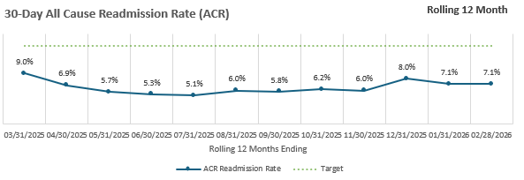
All cause readmission
Notes:
Here you can see the impact on our ACR (All-Cause Readmission Rate).
For context, the national average is 14–15%, and 18–19% for Medicare-specific populations. The rural Top Performers benchmark is 12–14%.
We performed well below these benchmarks—starting at 9% in March 2025, dropping to a low of 5.1% in July, and settling in at 7.1% in February of this year. This reflects the combined effect of timely follow-up, reducing barriers to care, in-home visits, care management support, and most importantly, patient engagement.
For a rural system like ours, this was a significant improvement—and a clear signal that our approach is working.

Slide 7
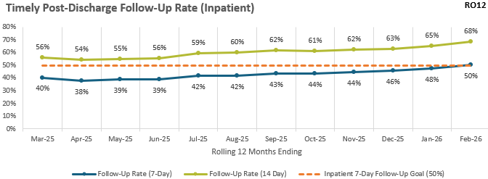
Notes:
Moving forward, you can see our 7- and 14-day post-discharge follow-up visit rates increased by at least10%, meeting—and surpassing—our goal of having 50% of patients seen within seven days.
And the trend keeps moving up. This reinforces what drives success: engaged patients, dedicated staff, consistent outreach, and in-home visits when access is the barrier.

Slide 8
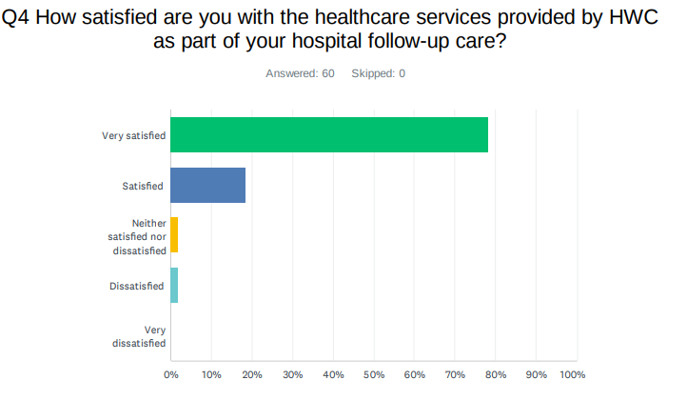
96% satisfied
Notes:
From a patient experience standpoint, 96% of our patients reported being satisfied.
That tells us we’re not just reducing readmissions—we’re helping patients feel supported and guided between visits.

Slide 9
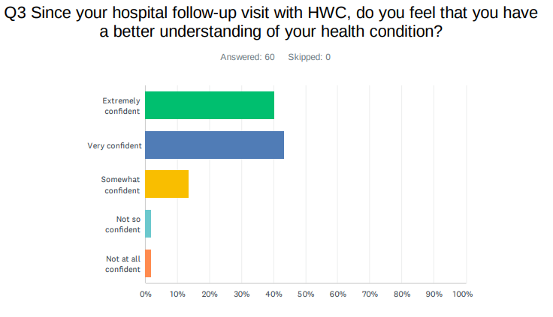
80% confidence
Notes:
And 80% of our patients reported confidence in managing their health. That’s a huge win—because confidence is what keeps small issues from turning into avoidable hospital visits.

Slide 10

So where do we go from here?
“THE GAME”-we will host a scavenger hunt style game to share tips on better health across several counties in our service area
Notes:
So where do we go from here?
We’re continuing to find creative ways to engage our communities and keep prevention top of mind.
One of our next initiatives is “The Game.”
It’s a scavenger hunt-style program across multiple counties in our service area—built to engage patients in a fun, practical way while reinforcing health tips on nutrition, blood pressure, diabetes, colon cancer screening, breast and cervical cancer screening, and MyChart participation.
Because at the end of the day, improving rural health outcomes takes more than clinic visits—it takes engagement that sticks.

Slide 11

Thank you!
Questions?
Notes:
Thank you for your time and attention today—and for your continued support of this work.
I’m happy to answer your questions.

