Slide 1
Human Centered Leadership:
Ensuring Connection, Trust & Care in a Digital Era
Shelly A. Waggoner, MS, CEBS, SHRM-SCP
Sr. Vice President, Human Resources

Slide 2
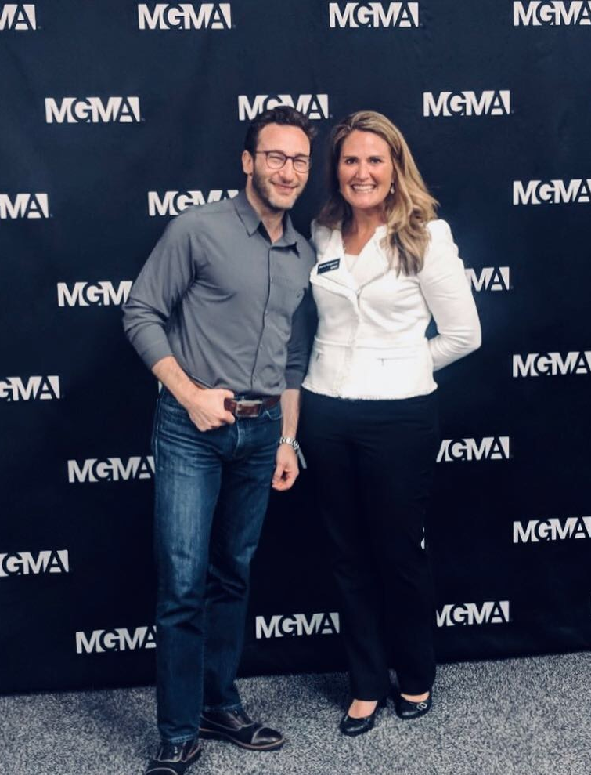
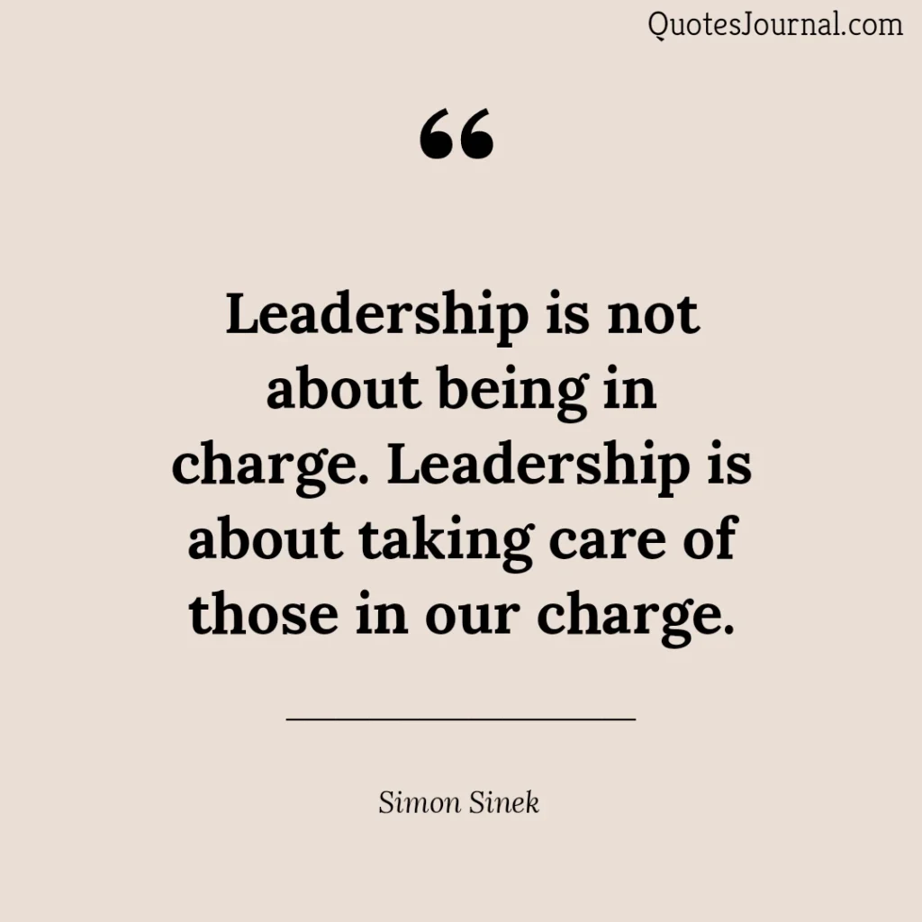

Slide 3


Human Centered Leadership
A leadership approach that puts people at the core of decision-making and organizational practices.

Slide 4
Why Human‑Centered Leadership Matters
It improves patient outcomes
It reduces burnout
It strengthens trust
It enhances the patient experience

Slide 5
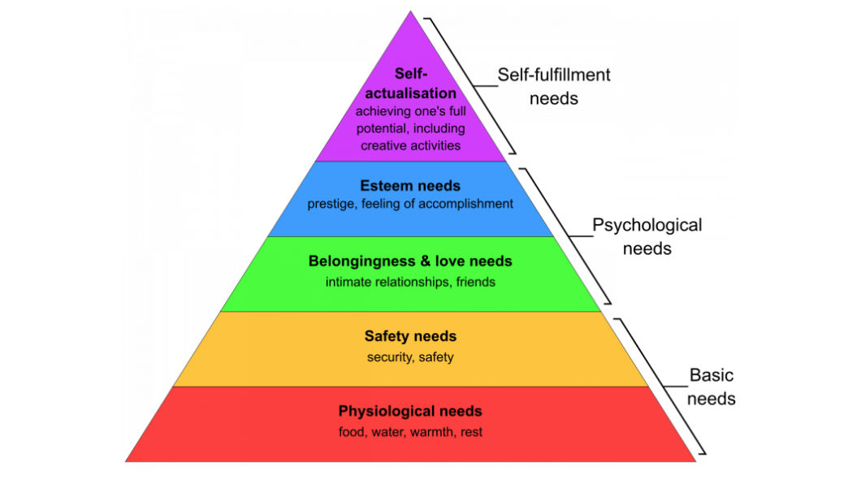

Slide 6
The Strongest Motivators of Performance
Purpose
Trust
Connection
Clarity
Growth
Recognition

Slide 7
Key Principles of Human Centered Leadership
Empathy & understanding
Trust & psychological safety
Purpose
Individual growth & development
Collaboration over control
Focus on mental health

Slide 8
You are the average of the 5 people you spend the most time with…”
Notes:
This concept has been popularized by Jim Rohn, highlighting the importance of our inner circle in personal development and suggests we should be strategic about the people we surround ourselves
Culture in the same way is infectious-

Slide 9
Applying Human Centered Leadership in a Digital Era
Design care around real human experiences
Use data with empathy, not just analytics
Create inclusive digital access
Support clinicians, not just “digitize” them

Slide 10
What Unites You
Leadership grounded in empathy and accountability
Reliable handoffs and coordination across settings
Designing systems around patient and caregiver experience
Notes:
The grantees

Slide 11
Call To Action
Keep humans at the center
Embrace technology…
but first ask the right questions
Measure what matters
Notes:
Questions:
-Does this make care feel more or less human?
-Is this the experience we want to create for the patient?
-Who might we leave behind in the process- ie. What are the unintended consequences? (Access to care)
-Does this help physicians do what they do best?- provide quality patient care
Measure what matters:
-Beyond cost per visit, # of visits per physician, etc.
-Measure patient trust and satisfaction, clinician burnout & engagement, health outcomes over time, etc.
AND ease of using digital tools!

Slide 12
As technology accelerates, our humanity must lead—because in healthcare, our legacy won’t be the tools we adopted, but the trust we built, the connections we protected and the lives we changed.”
Notes:
Closing:
Share our resources at Copic and how we provide ongoing support
“Together, we can continue to build a safer and more human centered healthcare system.”

Slide 13

Thank you for your time today.
Questions?
swaggoner@copic.com

